Slide 1

WELCOME
FALL 2026
REGISTRARS MEETING

Slide 2
PRESENTER
Sonia Kelly
LIJSL
Operations Manager
&
LEAGUE REGISTRAR

Slide 3
NOTICE REMINDER
AED REQUIREMENT
All member leagues within Eastern New York Youth Soccer Association (ENYYSA) and all clubs under each member league must comply with this NYS Public Health Law Requirement.
An AED Device must be readily accessible at every field complex that hosts any ENYYSA or LIJSL sanctioned club training/soccer games/tournaments/events.
Requires someone who is trained to operate an AED be present at every field complex that hosts ENYYSA or LIJSL sanctioned club training/soccer games/tournaments/events.
Each club must create a plan that includes the location of each AED at each facility; make sure that the AED is accessible at all times; that this information is distributed to all applicable club personnel.

Slide 4
US Youth Soccer
School Year Age Group Formation – Fall 2026
AGE GROUP FOR 2026-2027
U9 - 08/01/2017 – 07/31/2018
U10 – 08/01/2016 – 07/31/2017

Slide 5
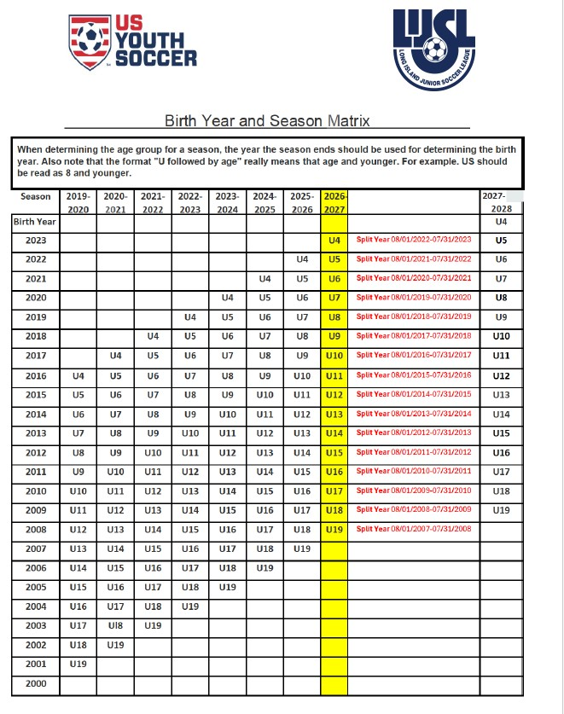

Slide 6
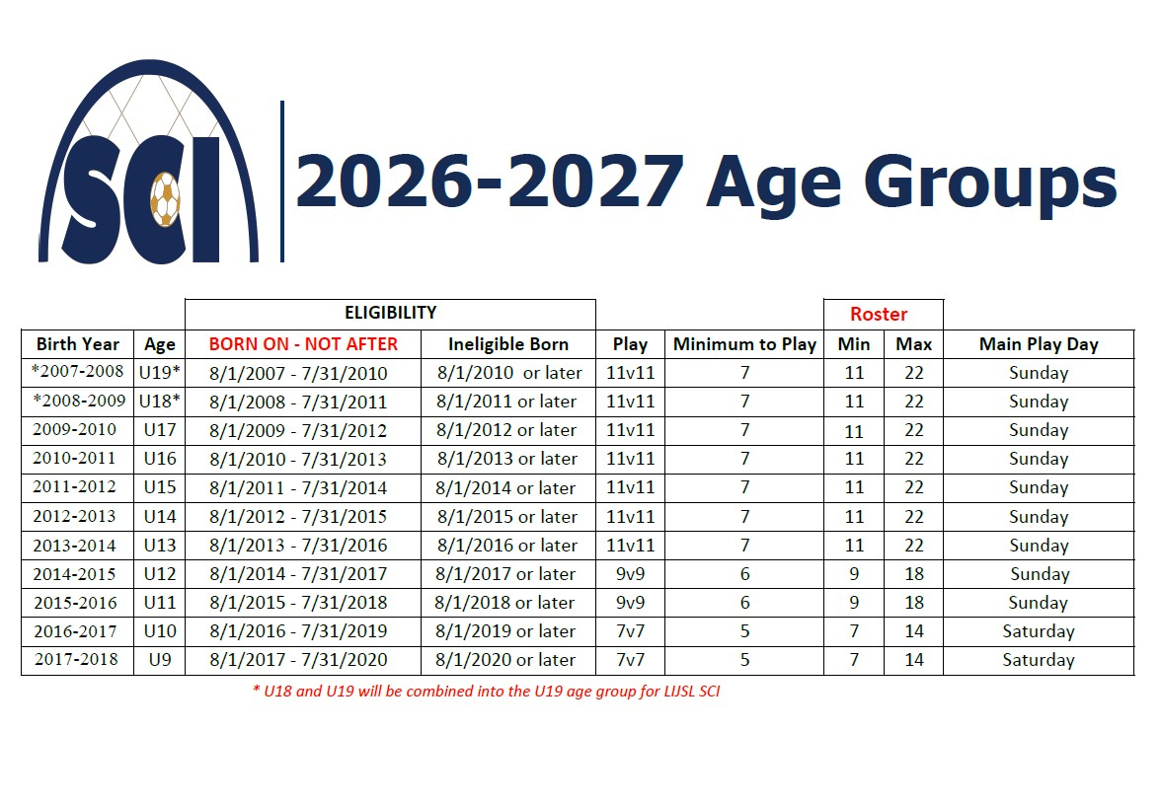

Slide 7
REGISTRATION APPOINTMENT DATES
CLUB/TEAM/ PLAYER
July 20, 2026 – July 21 , 2026
In Person or Mail In
REQUIRED - TEAM NAME / NUMBER SHEET
CONTACT
LIJSL OFFICE - 1.631.648.9020
Or
Erin Graydon – registrationservices@lijsoccer.com

Slide 8
Suffolk Country Interleague
Will No Longer Use
Player Passes
Coaches Passes Will Still Be Required

Slide 9
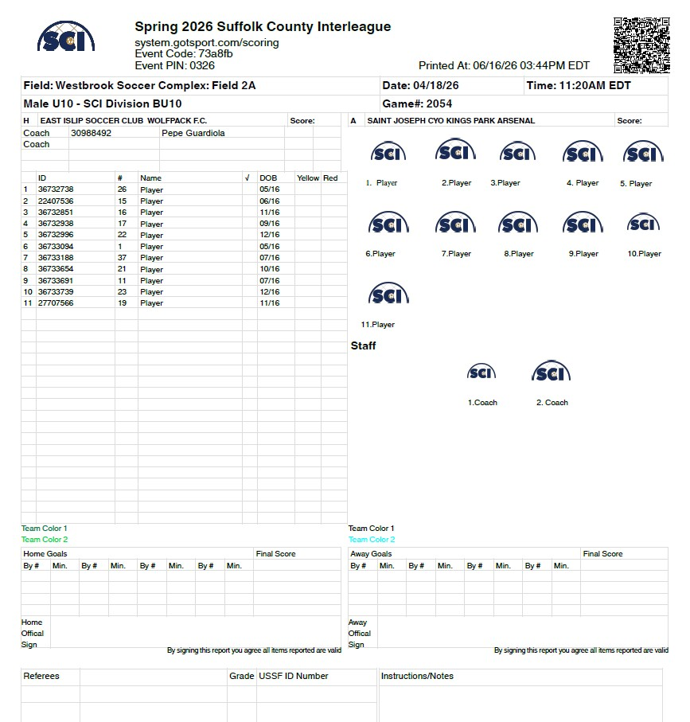
PHOTO MATCH DAY ROSTER

Slide 10
NO ROSTER MINIMUMS
Roster Minimums Will No Longer Be Required To Register A Team For The Fall 2026 League
Players must be registered by August 12, 2026
If The Player Minimums Are Not Met By August 12 And Team Goes To Scheduling, There Will Be No Refund If The Team Is Pulled From The Schedule.

Slide 11
House Keeping Check List
SCI Fall Season - Reset Rosters
1-Dashboard > Teams
1- Level – “Rec Plus”
2- Check Teams
3- Click “Reset Teams”
4- Select Roles to Reset – Click “Player”

Slide 12
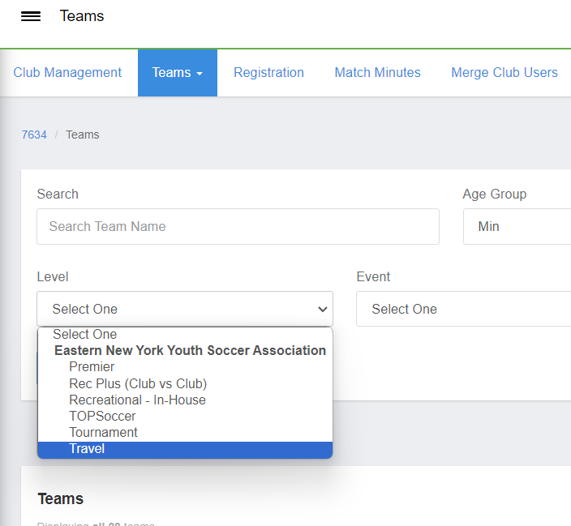
RESET ROSTERS
Level – “Rec Plus (Club vs Club)”

Slide 13
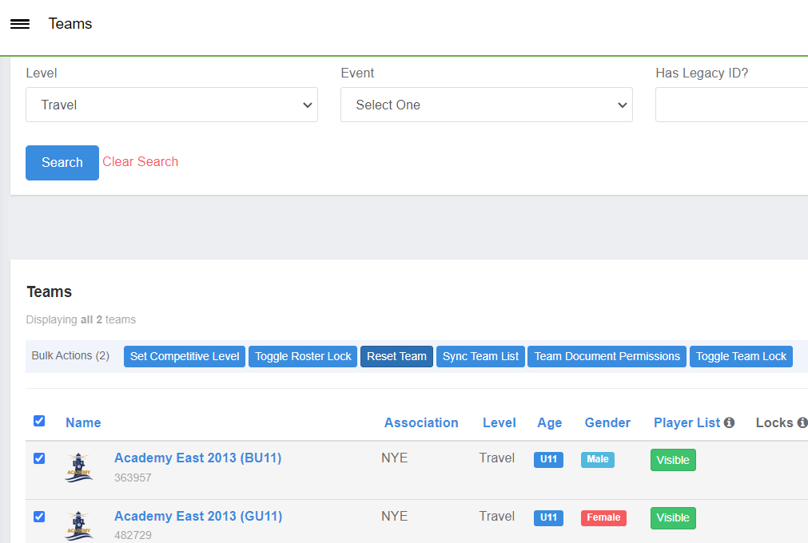
Level – “Travel, Premier or Tournament”
Check Teams & Click “Reset Teams”

Slide 14
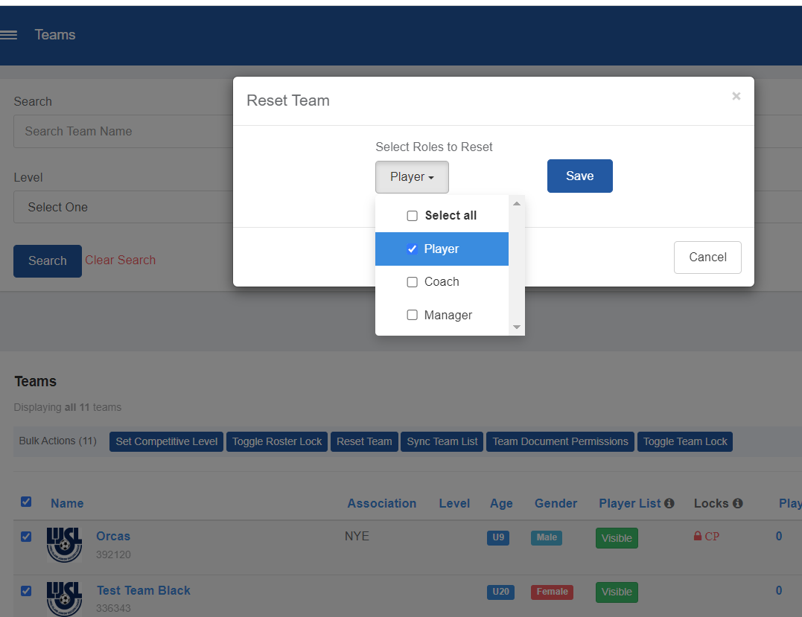
Select Roles to Reset – Click “Player”

Slide 15
CREATING REGISTRATION PROGRAM
8 Steps to Create a Program Registration
Step 1: Program Setup 🎥
This article will demonstrate how you can create the 'shell' of a program and input all of the basic settings based off of your Clubs preference.
Step 2: Registration Form 🎥
Registration Forms, an integral step of the registration, can be used for questions you want answered by the registrants, such as T-Shirt Size, or preferred team. As well as can be used for uploading documents such as Birth Certificates.
Step 3: Registration Fees 🎥
This article will demonstrate how to set up your fees for the registration so you can collect money.
Step 4: Appearance 🎥
This article will demonstrate how you can customize the look and feel of your program registration to fall more inline with your club’s colors and appearance.
Step 5: Features 🎥
While not required, Features can be an extremely useful tool for adding supplemental costs, or discounts, to a program registration.
Step 6: Adding a Birth Certificate 🎥
This article will demonstrate how to set up a Birth Certificate Repository for collection during registration.
Step 7: Adding Medical Release Forms
This article will demonstrate how to set up a form to gather and collect health care provider information
Step 8: Opening a Program Registration 🎥
The final step, opening your registration so your registrants can complete the program!

Slide 16
CLONE AN
EVENT/PROGRAM
OR
CREATE AN
EVENT/PROGRAM

Slide 17
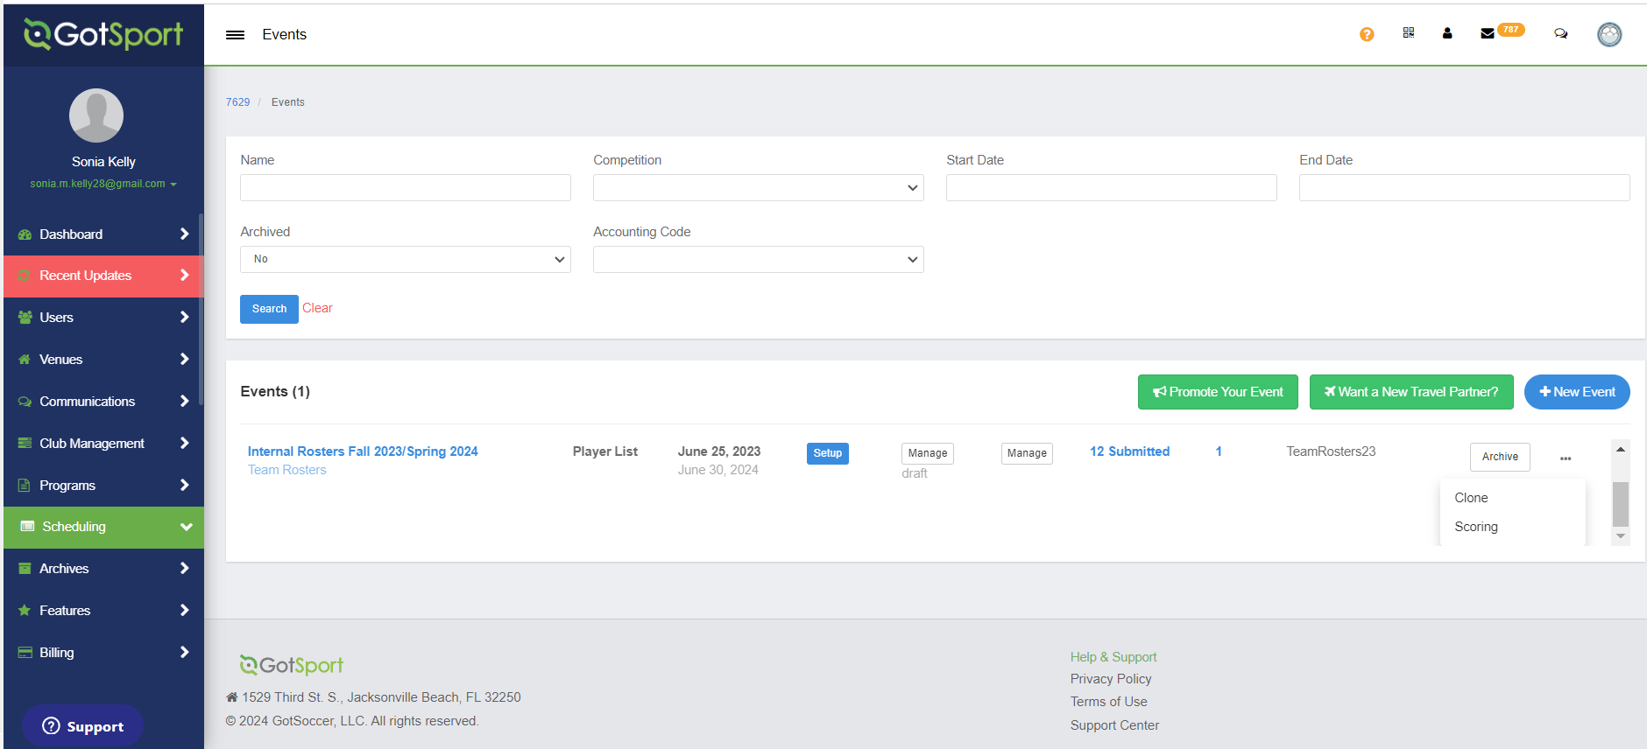
Clone 25/26 Internal Roster Event
Step 1:
Clone over internal rostering event for 2026/2027. 3

Slide 18
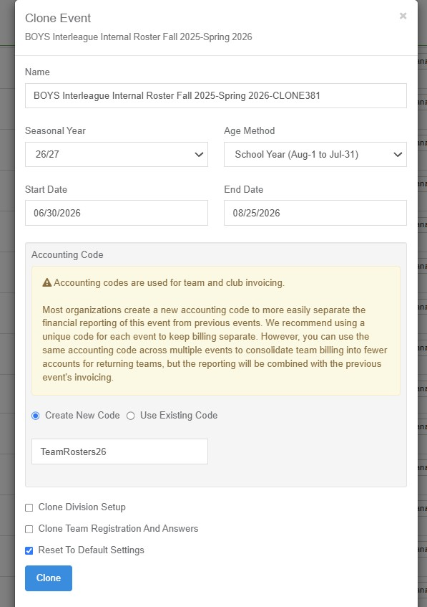
UPDATE INTERNAL ROSTER INFORMATION

Slide 19
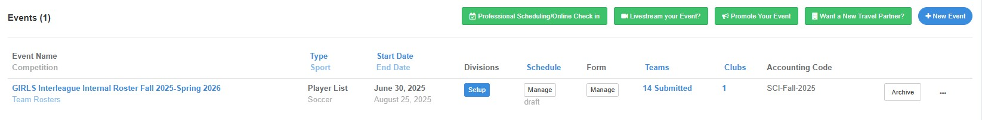
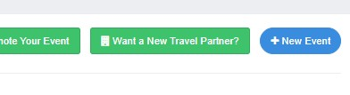
CREATE A NEW EVENT

Slide 20
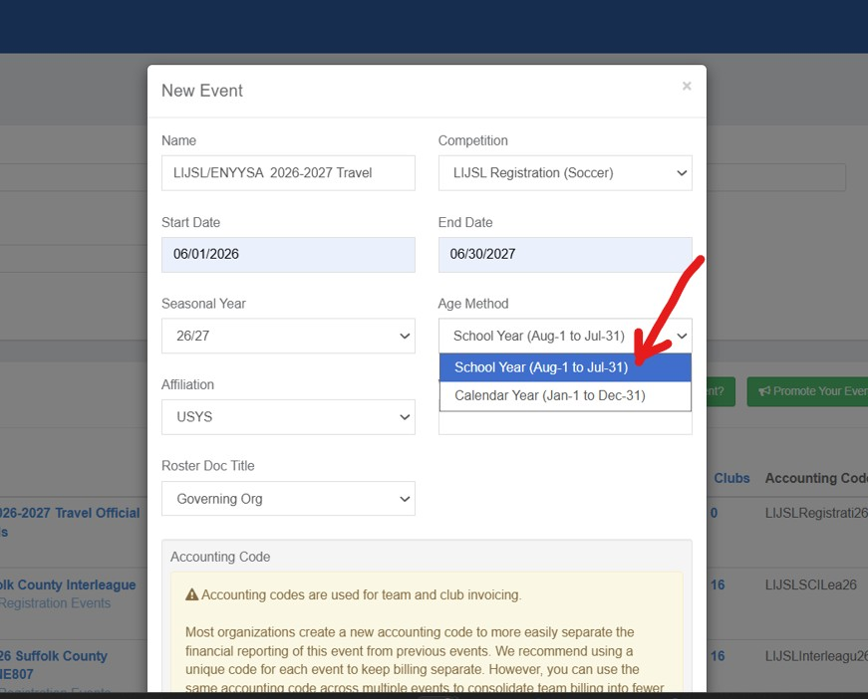

COMPLETE NEW EVENT INFORMATION

Slide 21
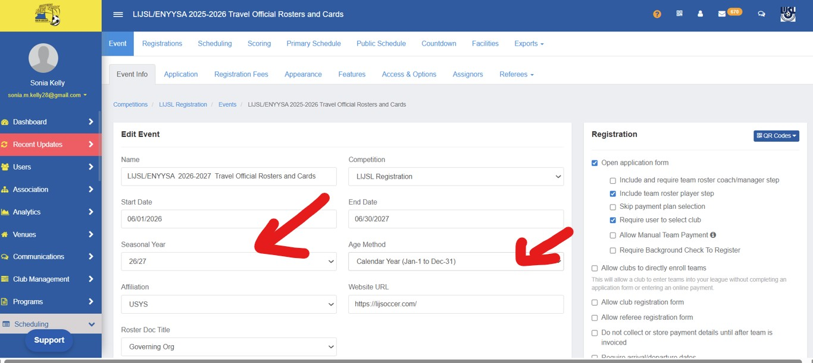

Slide 22
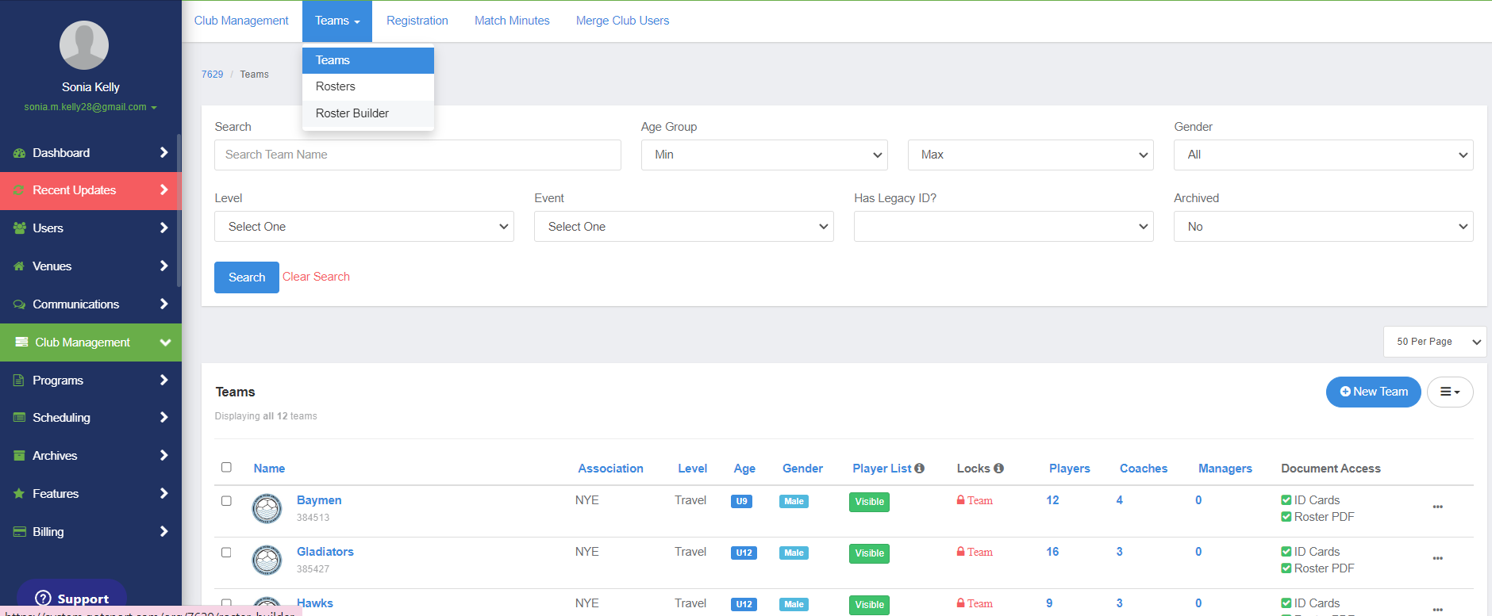
Move Players From Program Registration
To
Internal Roster Event
STEP 1: Dashboard > Teams > Roster Builder

Slide 23
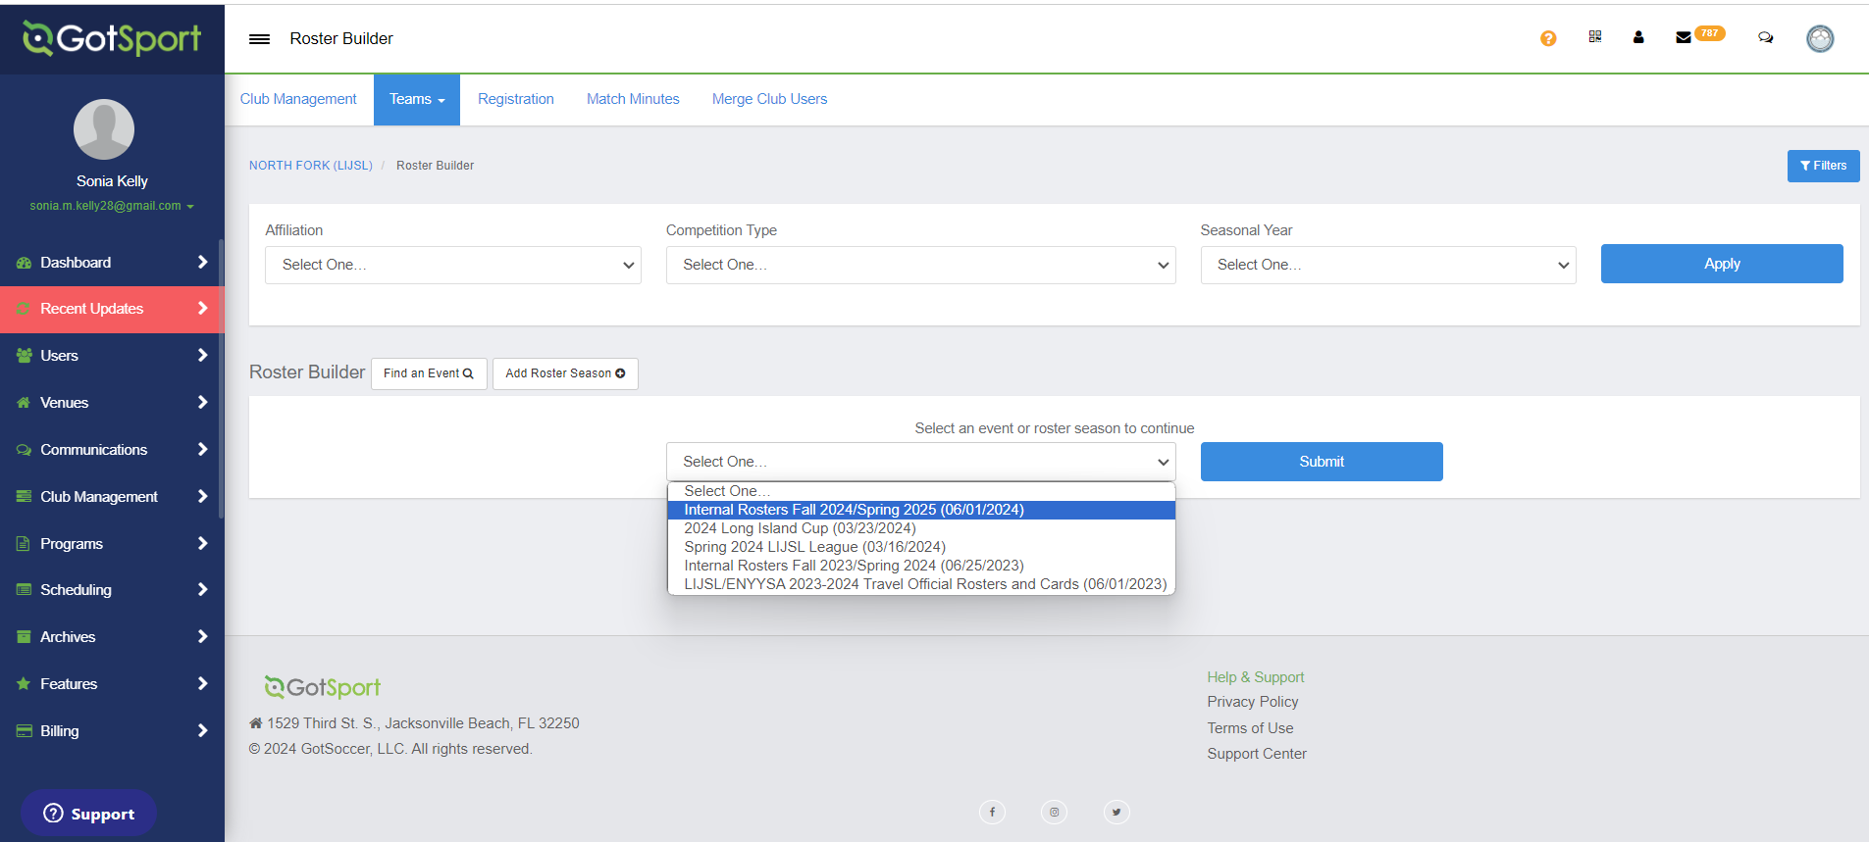
STEP 2: Select Event > SCI Internal Rosters Fall 2026

Slide 24
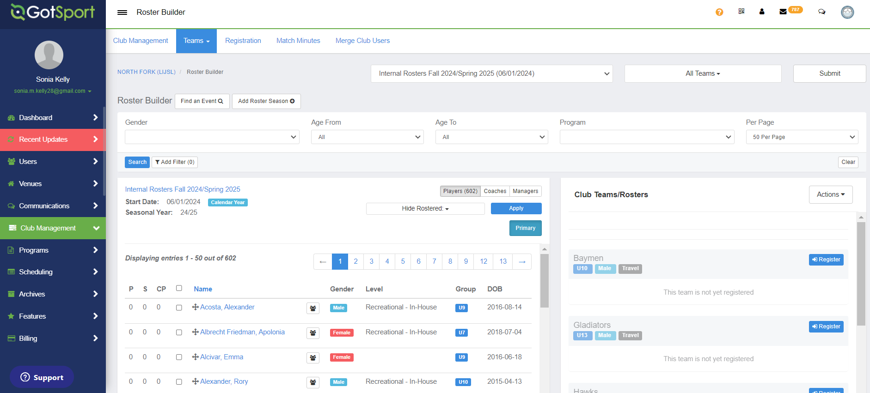
STEP 3: Activate/Register Teams

Slide 25
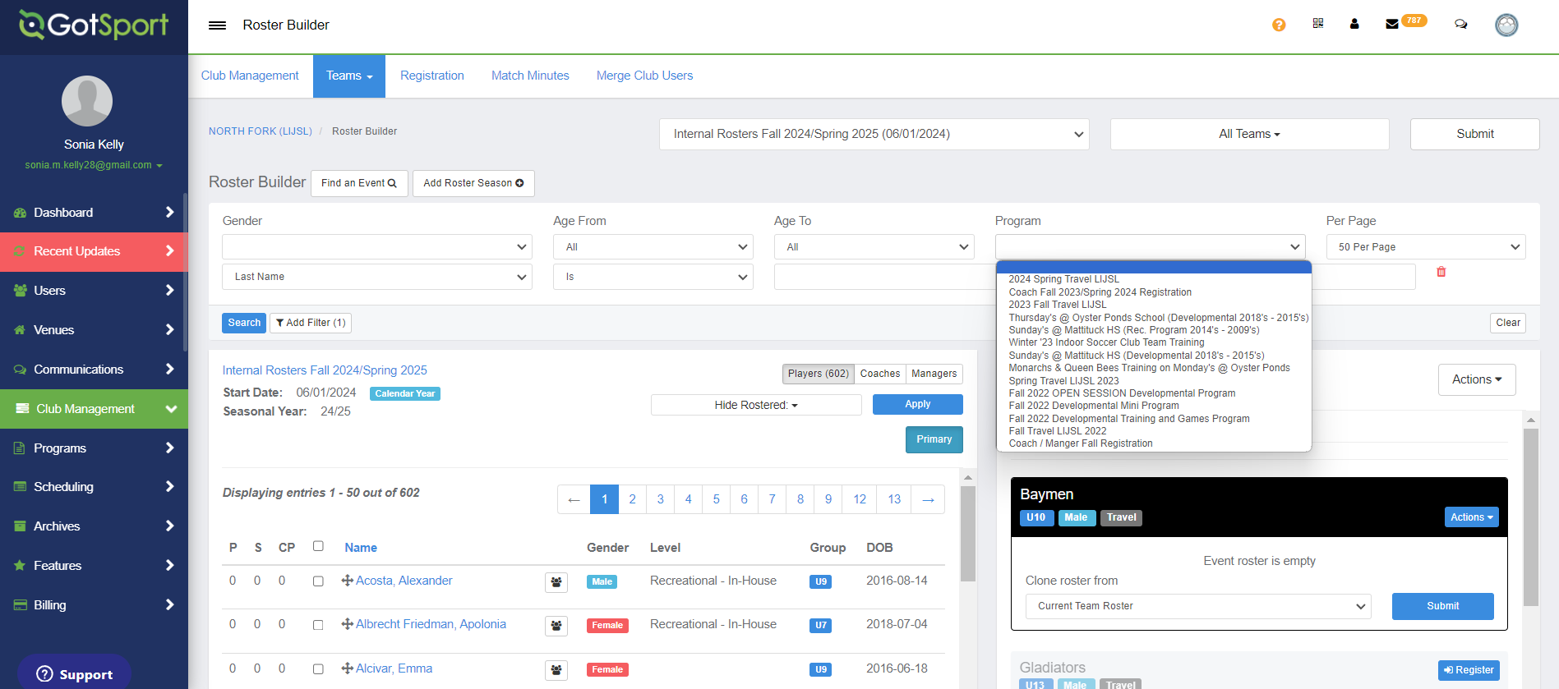
STEP 4: Select Program
2026-2027 SCI Registration

Slide 26
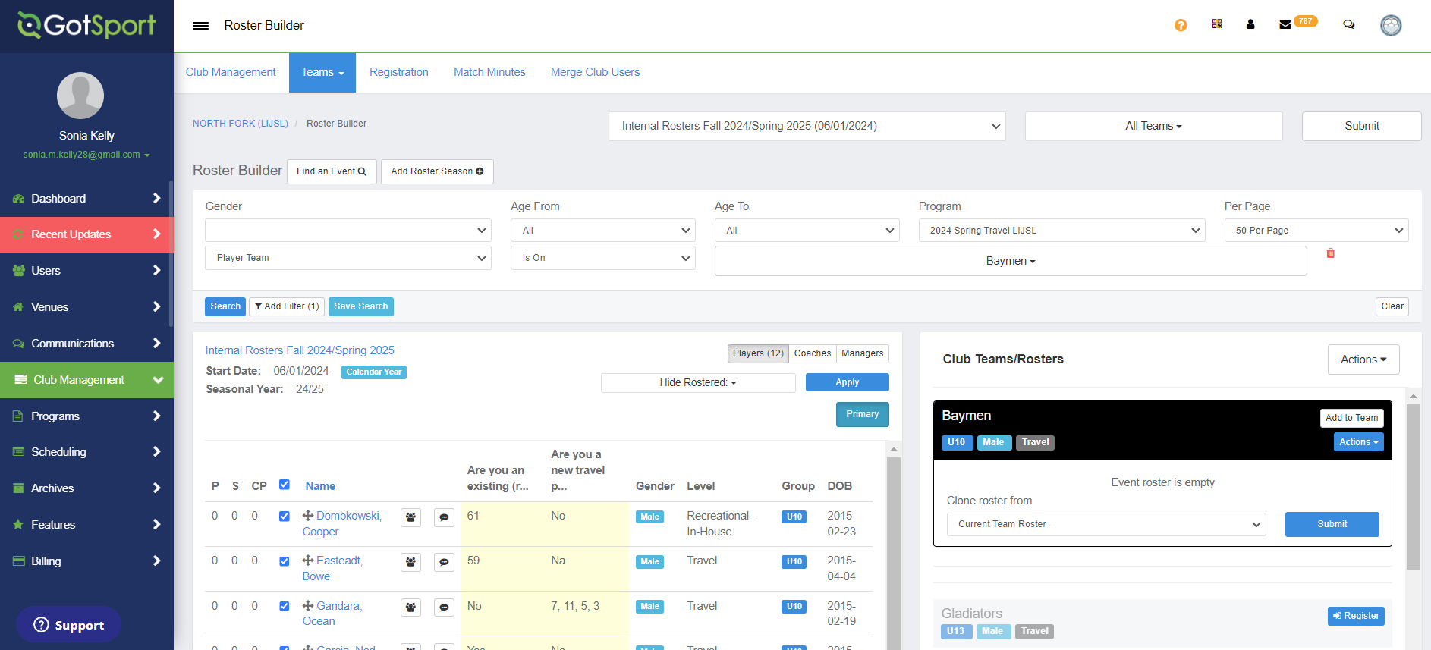
STEP 5: Add Filter: PLAYER TEAM

Slide 27
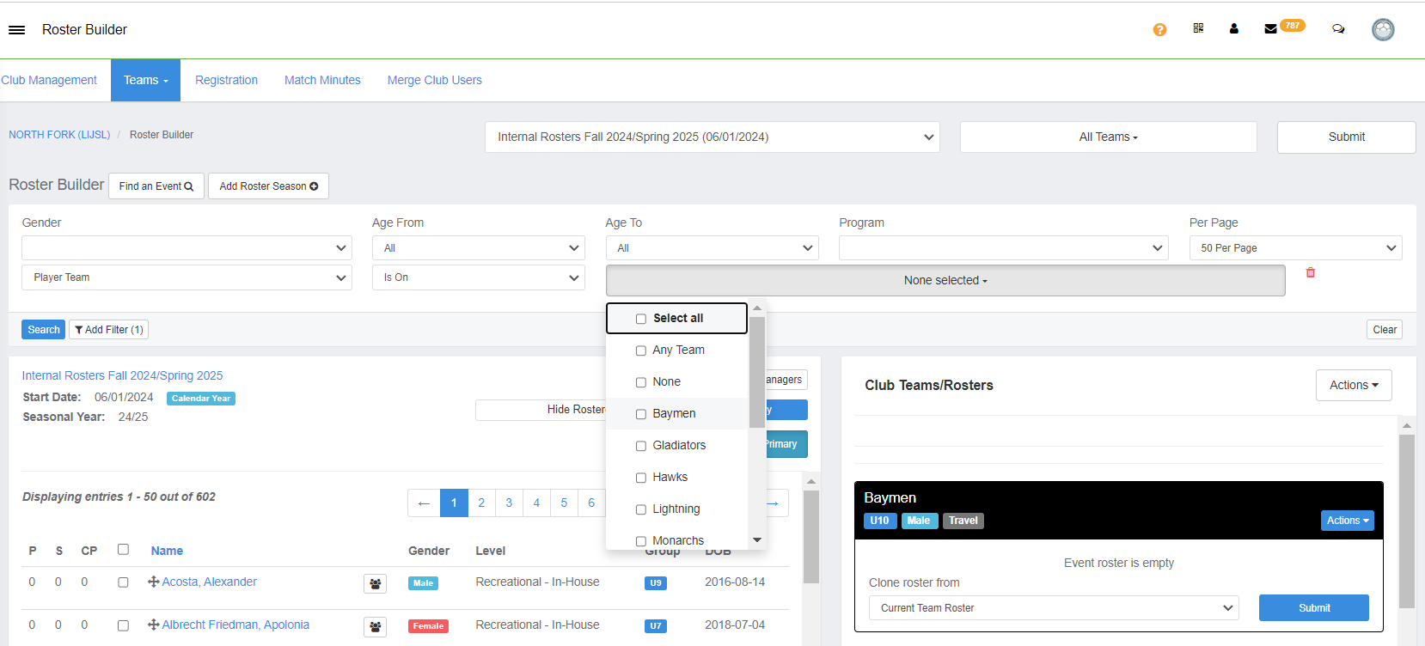
STEP 6: Sort by PLAYER TEAM

Slide 28
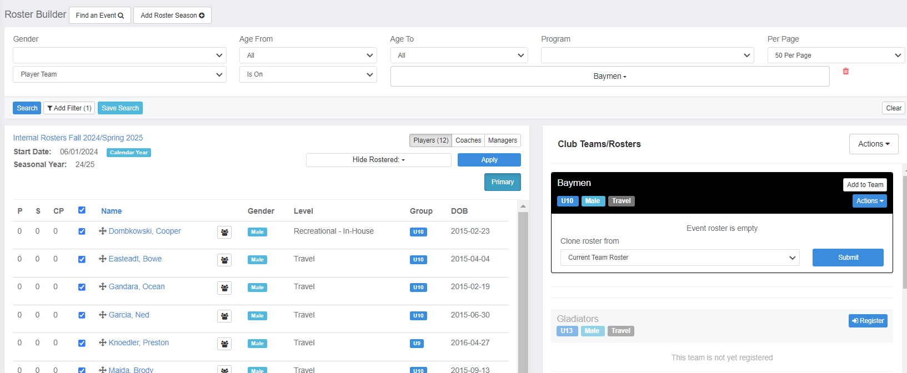
STEP 7: Select Players & Add to Team

Slide 29
REGISTRARS
July 1, 2026
Begin Enrolling Teams
into
LIJSL/ENYYSA 2026-2027
SCI OFFICIAL ROSTERS &
Cards

Slide 30
Fall 2026
Guide to Register TEAMS
Into
LIJSL/ENYYSA 2026-2027
SCI Official Rosters & Cards

Slide 31

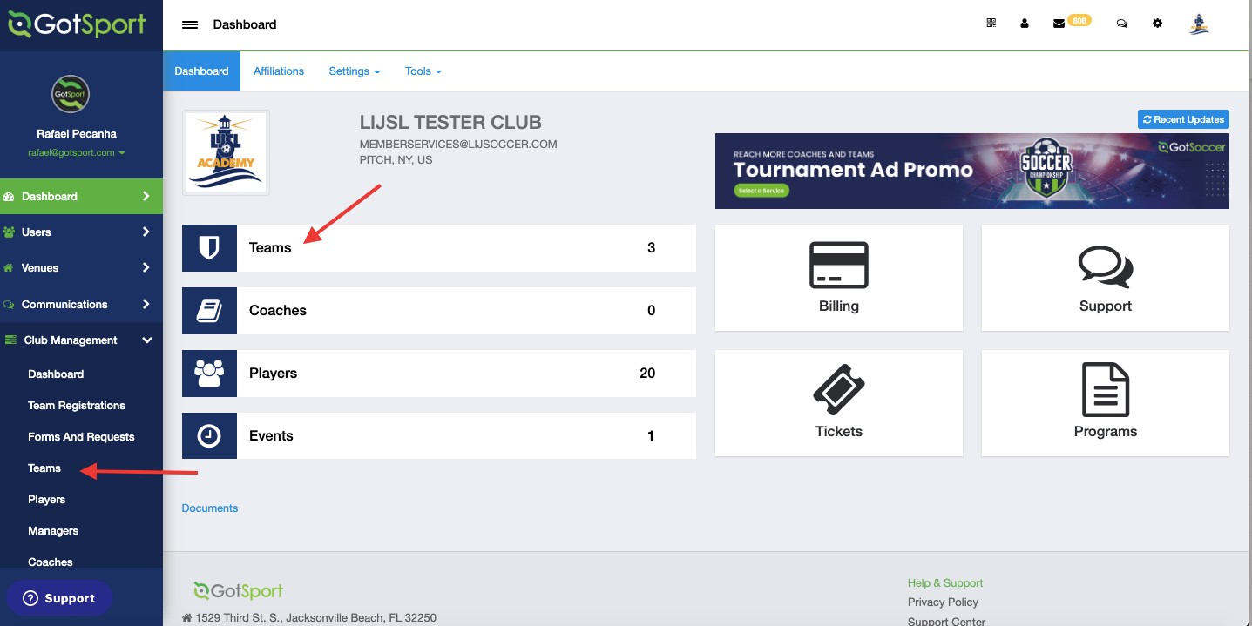
www.gotsport.com
TASK 1
Go to Teams List
Step 1: From your Dashboard, either select the Teams tab or click the Club Management module on the left-hand side and select Teams

Slide 32
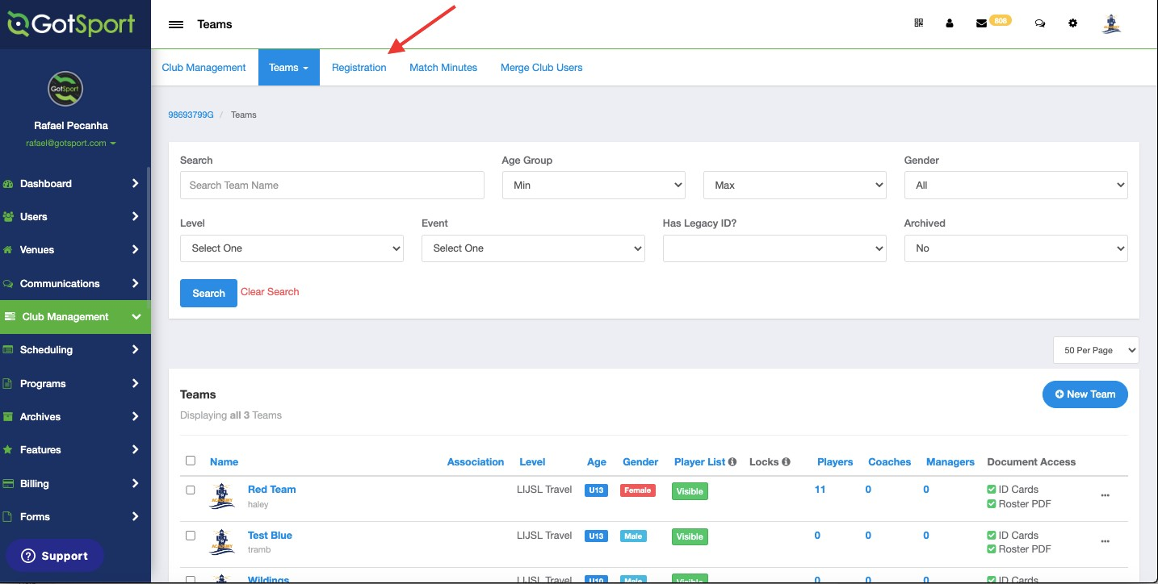
www.gotsport.com
TASK 2
Click Registration Tab
Step 1: Once On the Teams Page, Click Registration Tab to scroll Down and Find The Official Event for LIJSL

Slide 33
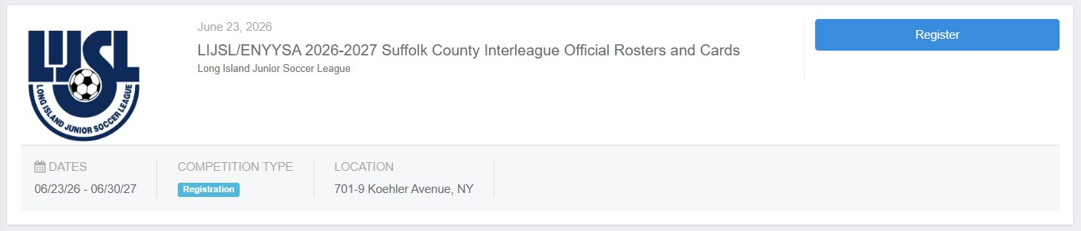
Locate the ENYYSA/LIJSL 2026/2027 official rosters & cards event
TASK 3

Slide 34
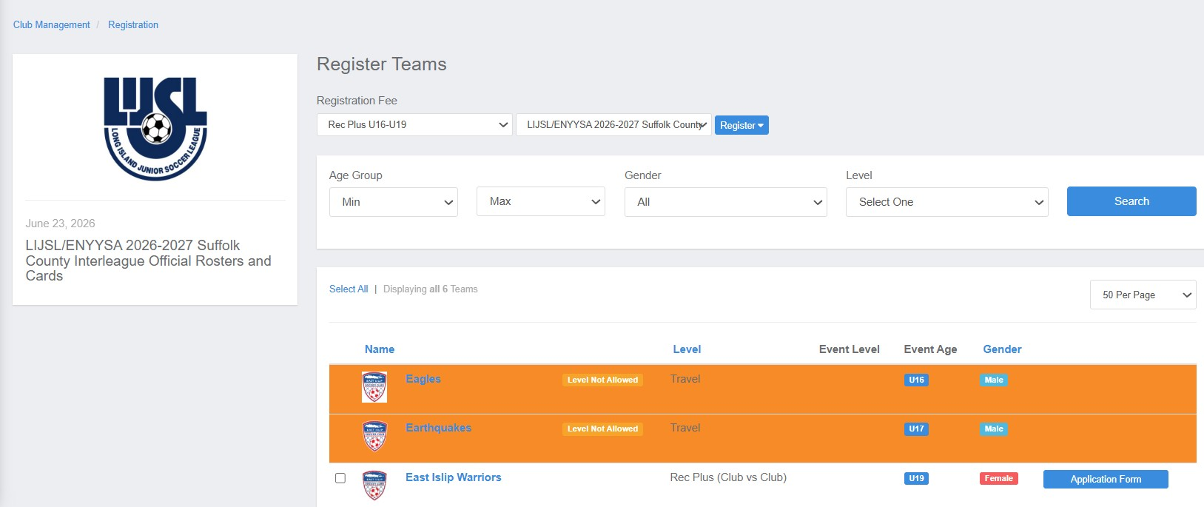
TASK 4
Register for the roster and player cards event
Step 1: Click The Register Button From the Previous Image. Then Click Application Form. You Need To Register One Team At A Time then return to this screen and register the next team.

Slide 35
In Case You See A Message Stating That The Level Is Not Allowed, You Can Click On The Team Name and Change it Before Clicking Save At The Bottom.

Slide 36
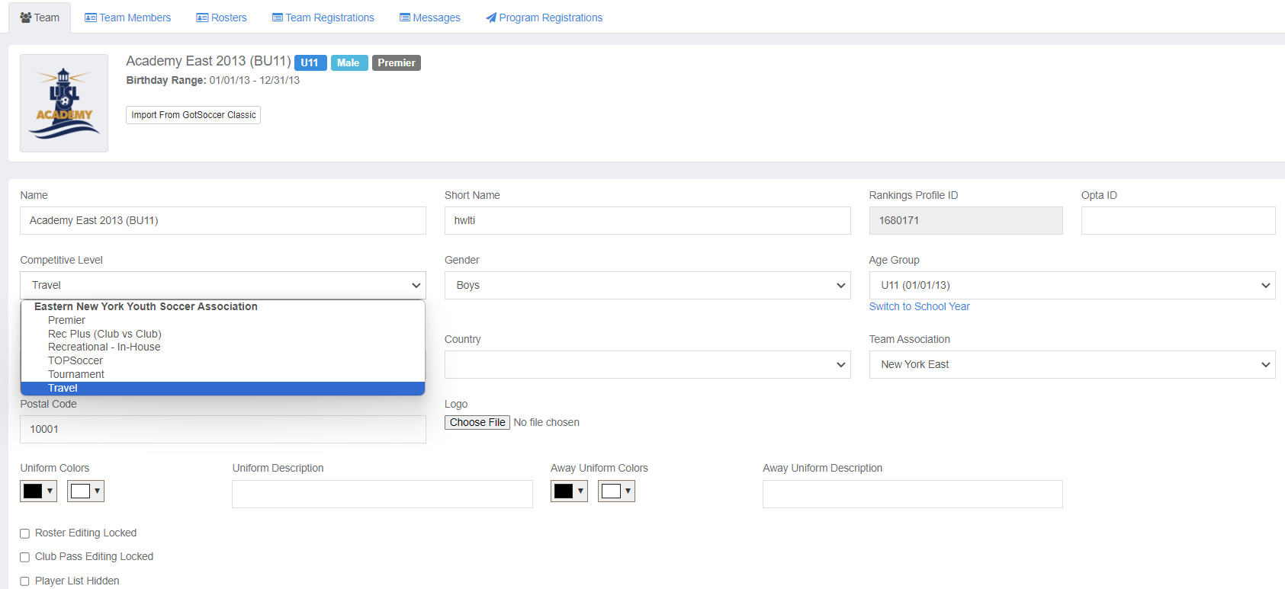
Click “Competitive Level” And Make Sure Rec Plus (Club vs Club) is Selected.

Slide 37
SCI Team Fee - $250
Player Fee - $13.00
Designated Player Fee - $5.00 (Max 3 per Team)
ROSTER MAX –
U9 – U10 # 14
U11–U12 # 18
U13-U19 # 22

Slide 38
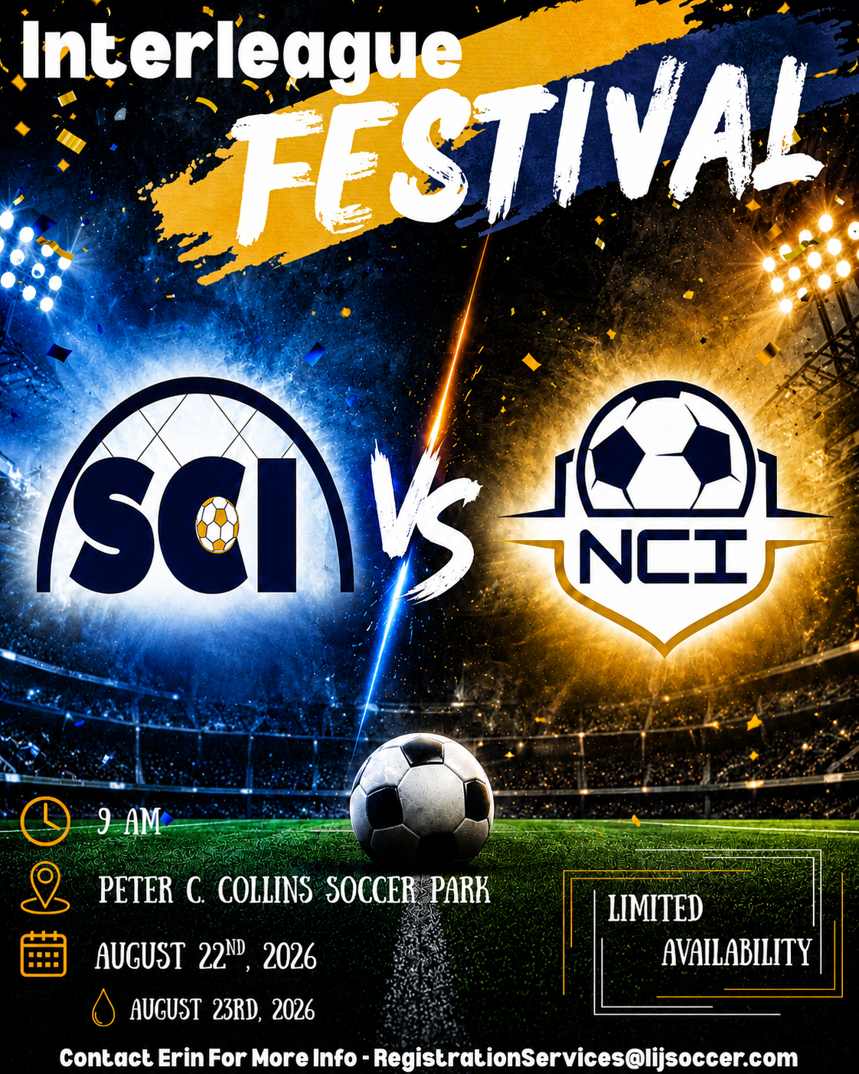

Slide 39

HAVE A GREAT FALL SEASON
#BuildingCharacterThroughSoccer

