Slide 1

WELCOME
FALL 2026
REGISTRARS MEETING

Slide 2
PRESENTER
Sonia Kelly
LIJSL
Operations Manager
&
LEAGUE REGISTRAR

Slide 3
NOTICE REMINDER
AED REQUIREMENT
All member leagues within Eastern New York Youth Soccer Association (ENYYSA) and all clubs under each member league must comply with this NYS Public Health Law Requirement.
An AED Device must be readily accessible at every field complex that hosts any ENYYSA or LIJSL sanctioned club training/soccer games/tournaments/events.
Requires someone who is trained to operate an AED be present at every field complex that hosts ENYYSA or LIJSL sanctioned club training/soccer games/tournaments/events.
Each club must create a plan that includes the location of each AED at each facility; make sure that the AED is accessible at all times; that this information is distributed to all applicable club personnel.

Slide 4
US Youth Soccer
School Year Age Group Formation – Fall 2026
AGE GROUP FOR 2026-2027
U9 - 08/01/2017 – 07/31/2018
U10 – 08/01/2016 – 07/31/2017

Slide 5
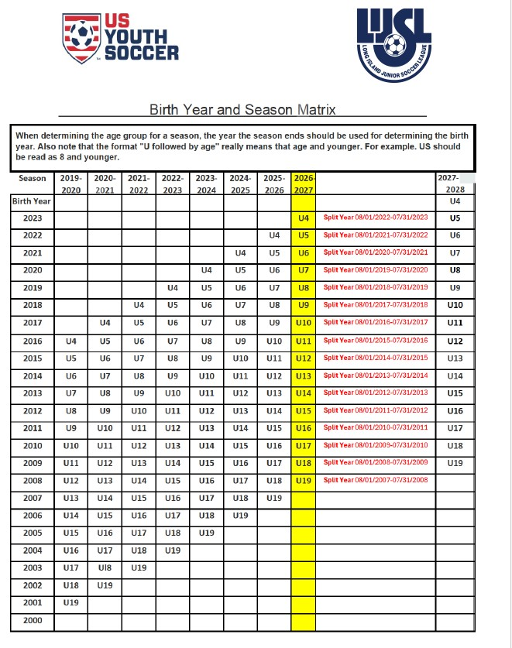

Slide 6
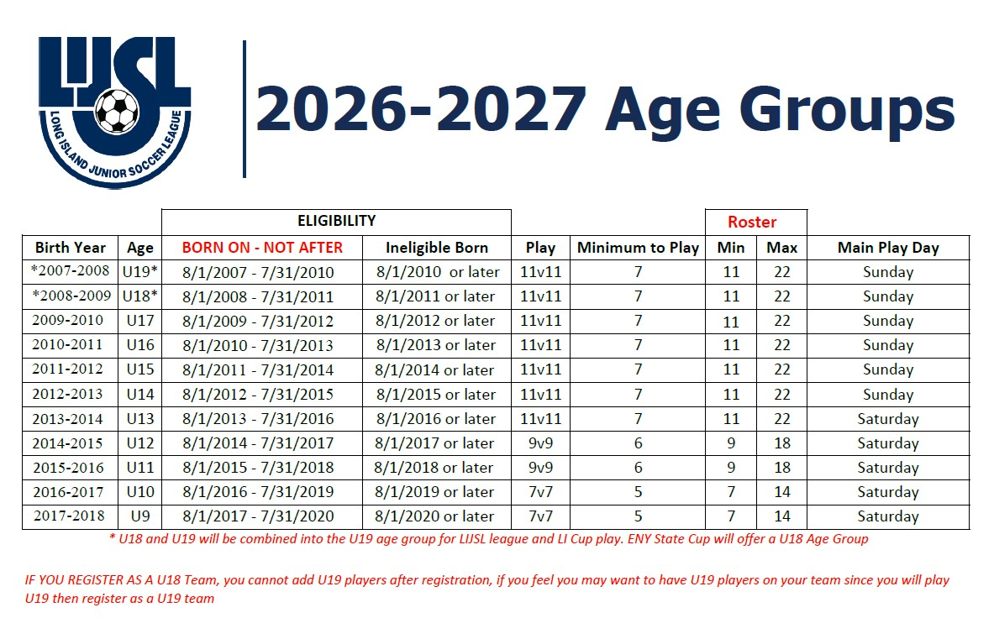

Slide 7
REGISTRATION APPOINTMENT DATES
June 29, 2026 – July 17 , 2026
8:30 AM - 7:00 PM
Saturday July 11th (If Needed)
8:00 AM - 12:00 PM
All Mail Ins Must be in Office by July 8, 2026
CONTACT
LIJSL OFFICE - 1.631.648.9020
HALEY KOZIK – adminservices@lijsoccer.com
Or
Erin Graydon – registrationservices@lijsoccer.com
** YOU CANNOT CHANGE THE DATE Once An Appointment Is Made**

Slide 8
All U15 – U19 Players
WILL HAVE THEIR PHOTOS REMOVED FROM THEIR PROFILES.
All PHOTOS WILL NEED TO BE REPLACED

Slide 9
ALL JERSEY NUMBERS MUST BE ON MATCH DAY ROSTER

Slide 10
House Keeping Check List
Fall Season - Reset Rosters
1-Dashboard > Teams
1- Level – “Travel, Premier or
Tournament”
2- Check Teams
3- Click “Reset Teams”
4- Select Roles to Reset – Click “Player”

Slide 11
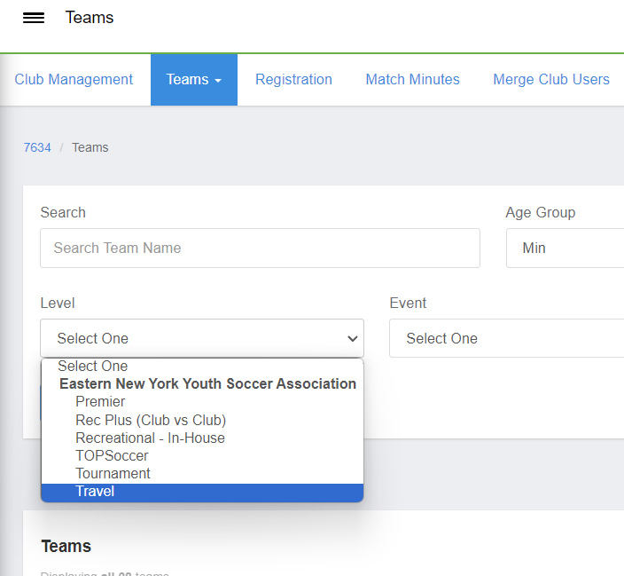
RESET ROSTERS
Level – “Travel, Premier or Tournament”

Slide 12
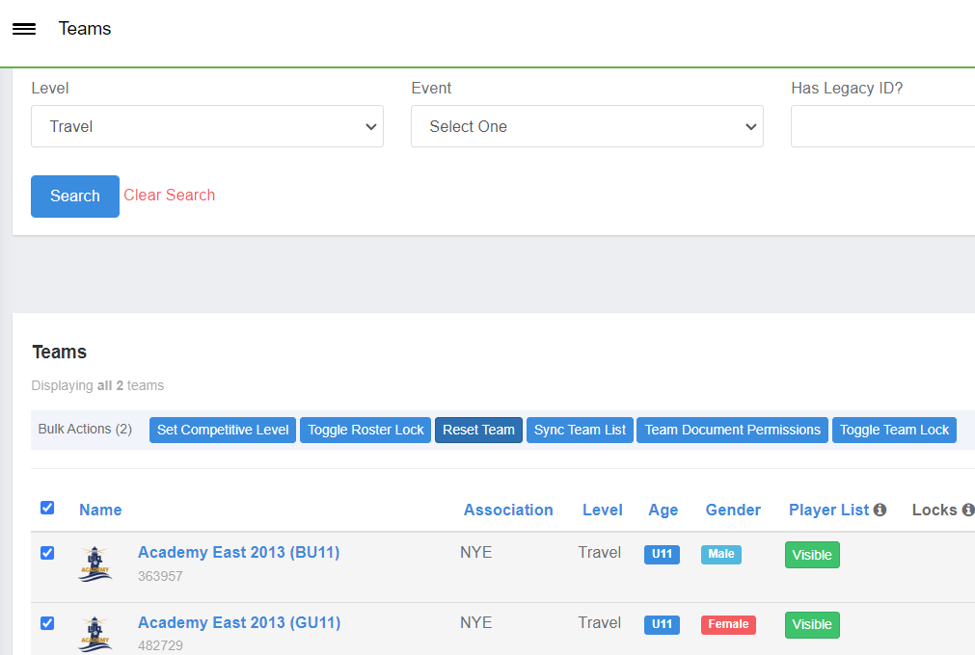
Level – “Travel, Premier or Tournament”
Check Teams & Click “Reset Teams”

Slide 13
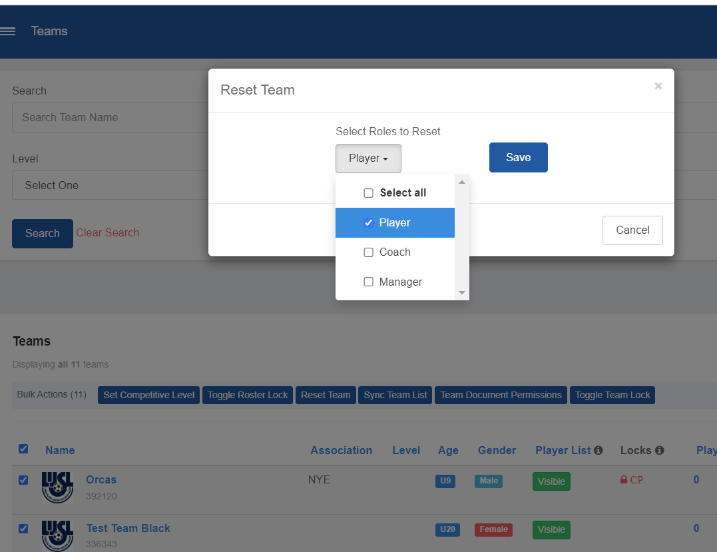
Select Roles to Reset – Click “Player”

Slide 14
CREATING REGISTRATION PROGRAM
8 Steps to Create a Program Registration
Step 1: Program Setup 🎥
This article will demonstrate how you can create the 'shell' of a program and input all of the basic settings based off of your Clubs preference.
Step 2: Registration Form 🎥
Registration Forms, an integral step of the registration, can be used for questions you want answered by the registrants, such as T-Shirt Size, or preferred team. As well as can be used for uploading documents such as Birth Certificates.
Step 3: Registration Fees 🎥
This article will demonstrate how to set up your fees for the registration so you can collect money.
Step 4: Appearance 🎥
This article will demonstrate how you can customize the look and feel of your program registration to fall more inline with your club’s colors and appearance.
Step 5: Features 🎥
While not required, Features can be an extremely useful tool for adding supplemental costs, or discounts, to a program registration.
Step 6: Adding a Birth Certificate 🎥
This article will demonstrate how to set up a Birth Certificate Repository for collection during registration.
Step 7: Adding Medical Release Forms
This article will demonstrate how to set up a form to gather and collect health care provider information
Step 8: Opening a Program Registration 🎥
The final step, opening your registration so your registrants can complete the program!

Slide 15
CLONE AN
EVENT/PROGRAM
OR
CREATE AN
EVENT/PROGRAM

Slide 16
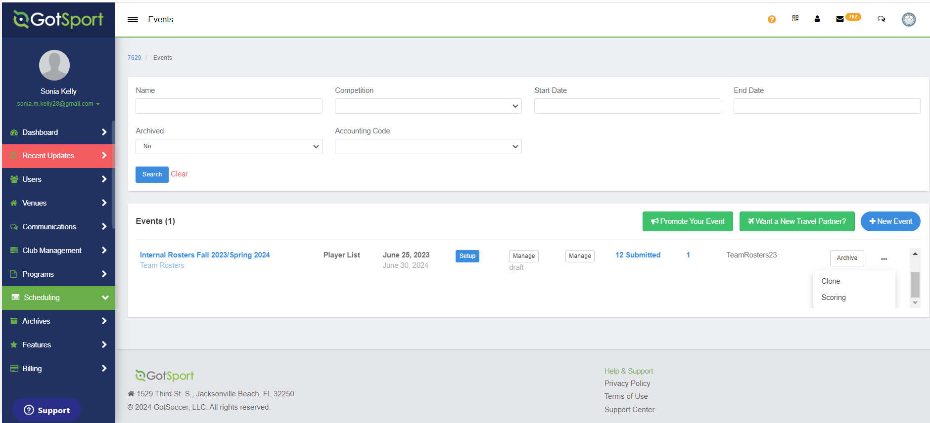
Clone 25/26 Internal Roster Event
Step 1:
Clone over internal rostering event for 2025/2026. 3

Slide 17
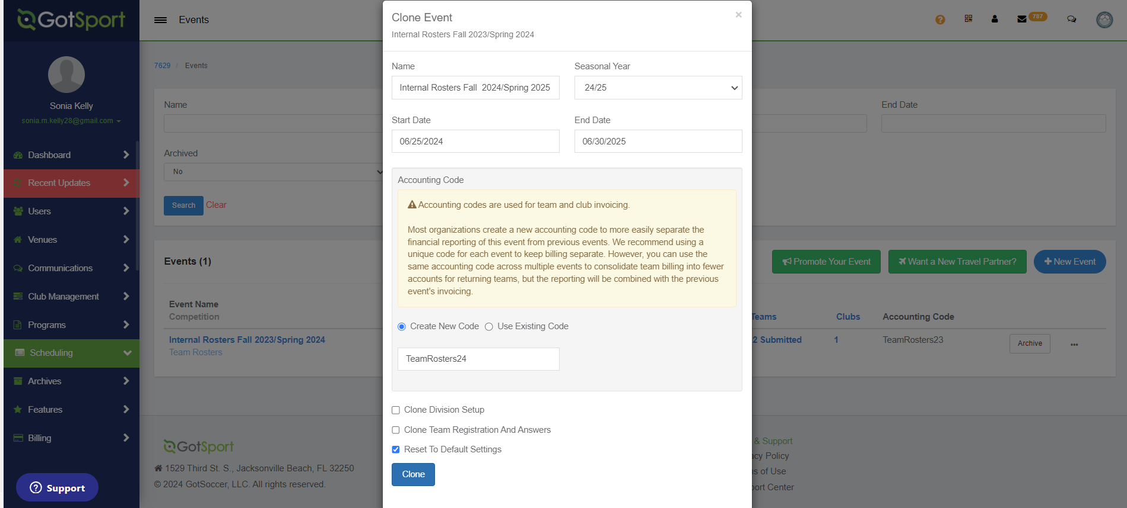
UPDATE INTERNAL ROSTER INFORMATION

Slide 18
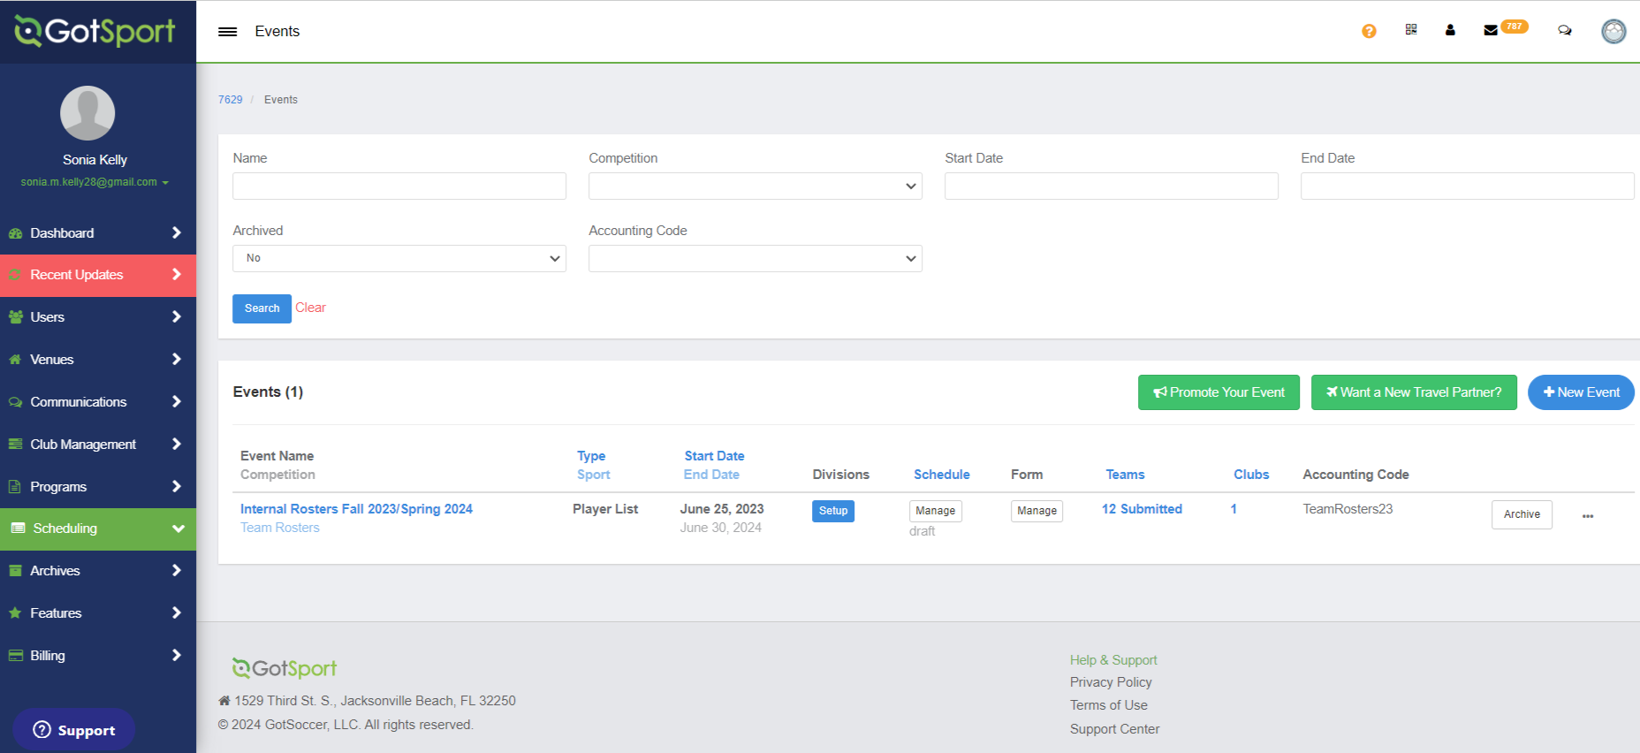
CREATE A NEW EVENT

Slide 19
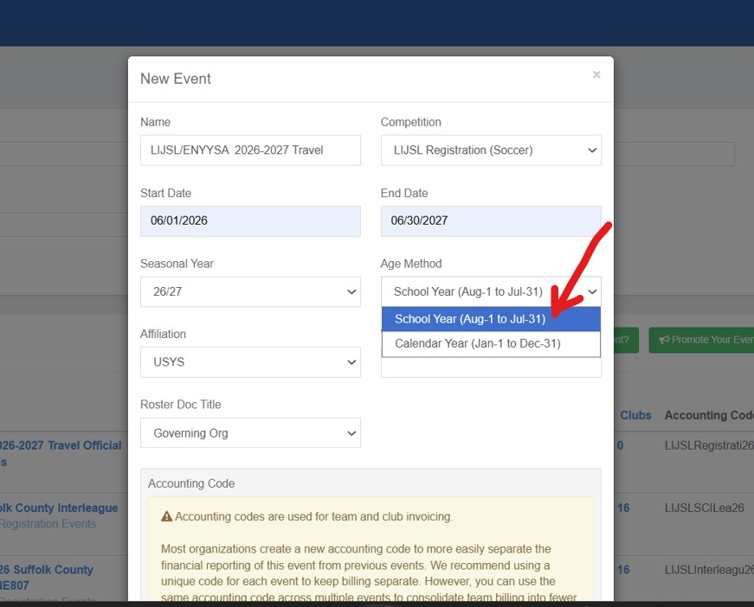
COMPLETE NEW EVENT INFORMATION

Slide 20
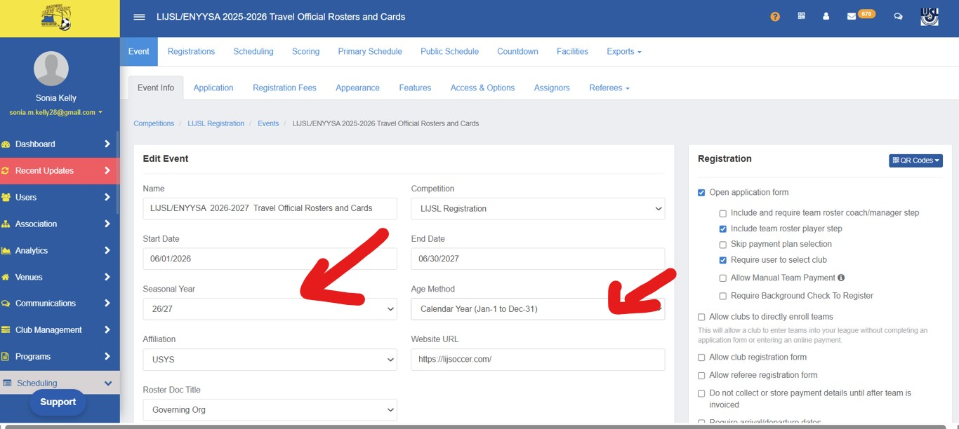

Slide 21
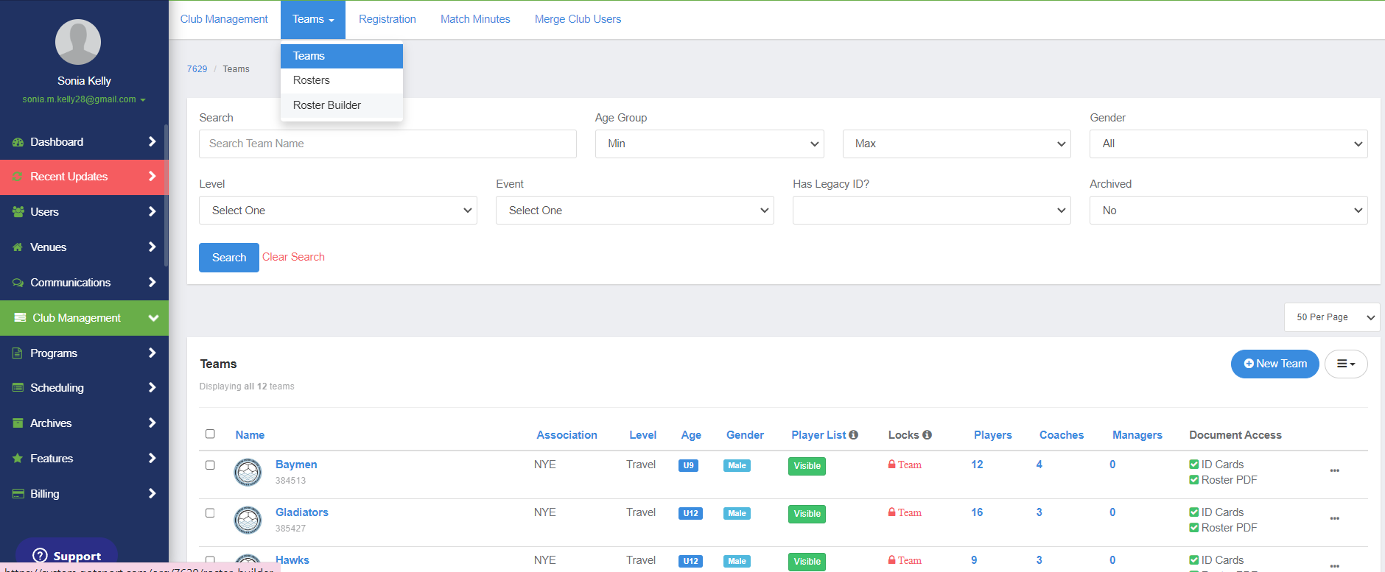
Move Players From Program Registration
To
Internal Roster Event
STEP 1: Dashboard > Teams > Roster Builder

Slide 22
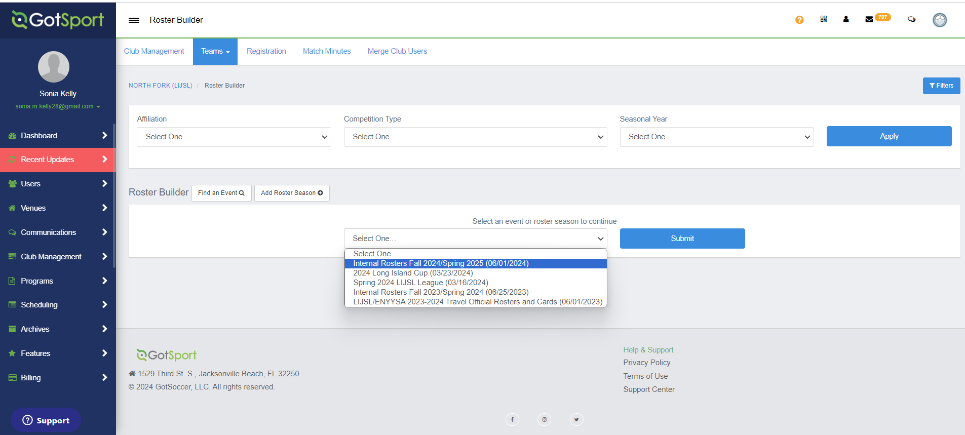
STEP 2: Select Event > Internal Rosters Fall 2026

Slide 23
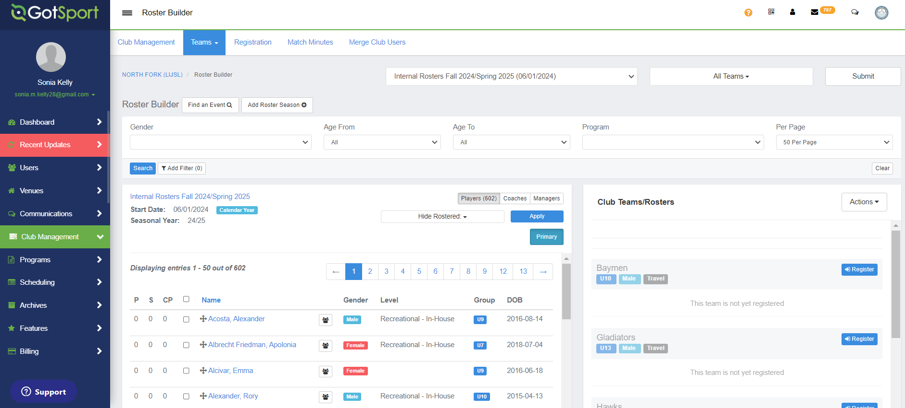
STEP 3: Activate/Register Teams

Slide 24
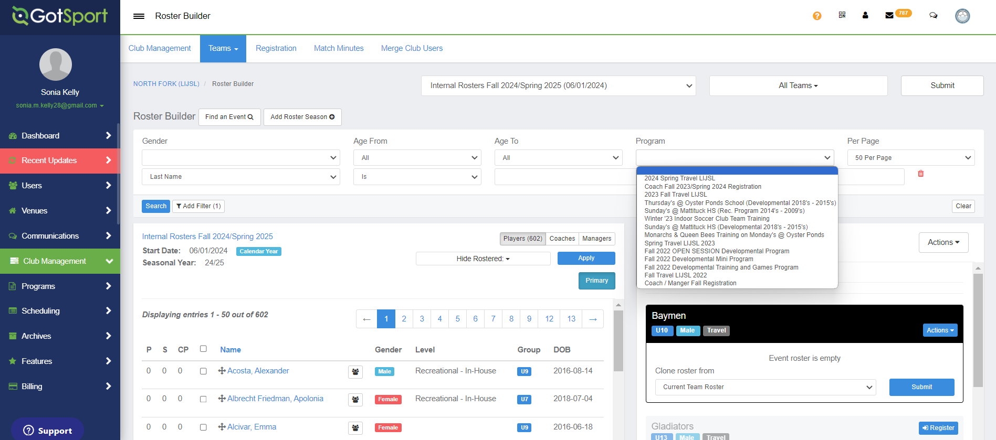
STEP 4: Select Program
2026-2027 Travel Registration

Slide 25
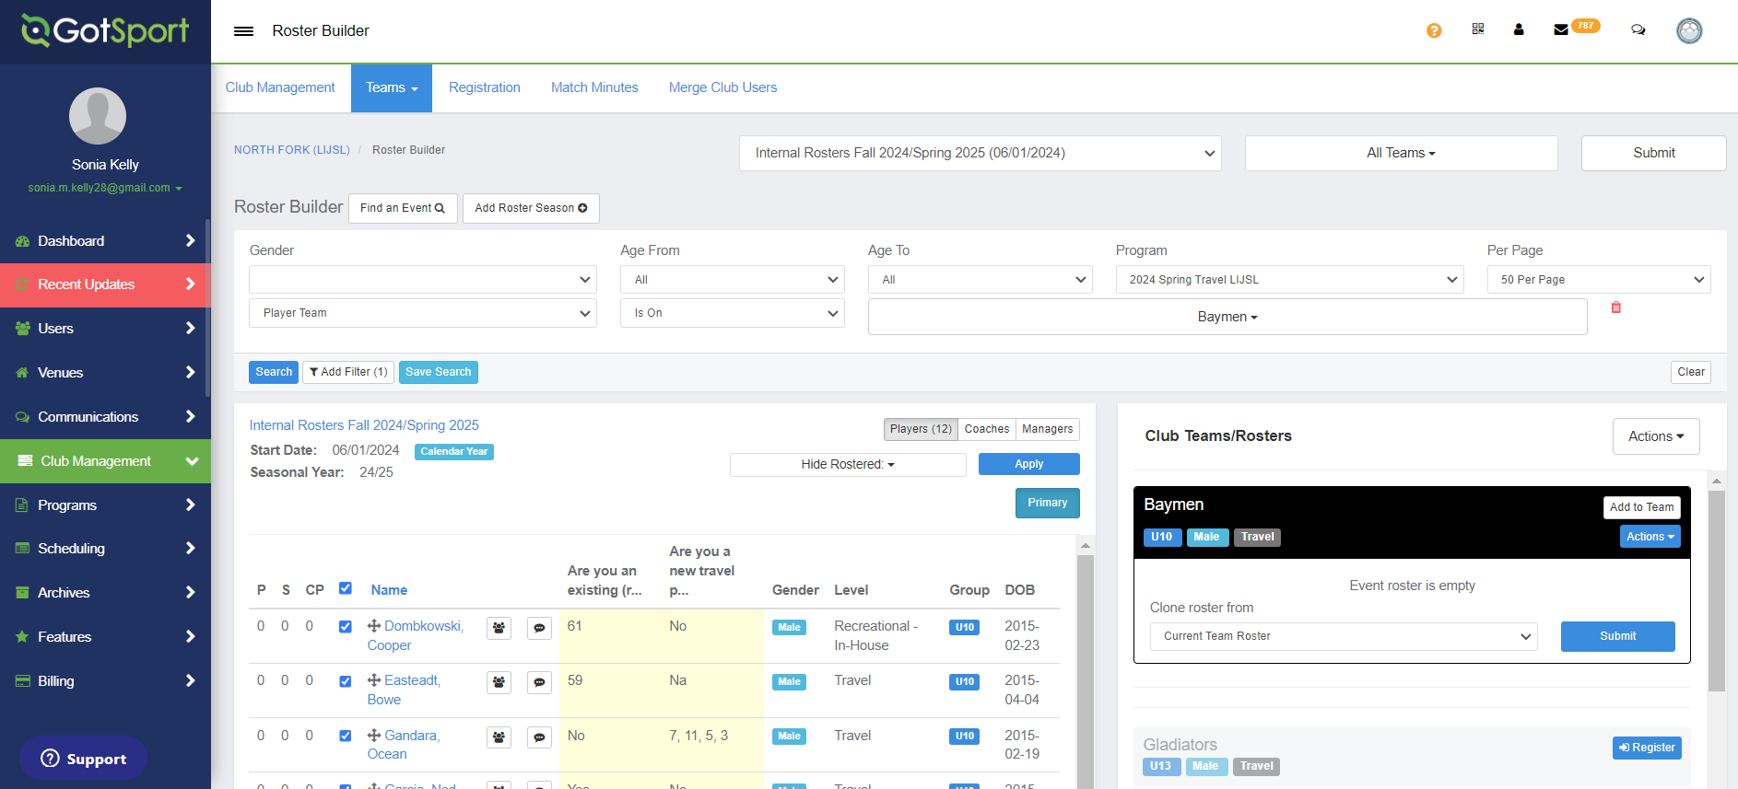
STEP 5: Add Filter: PLAYER TEAM

Slide 26
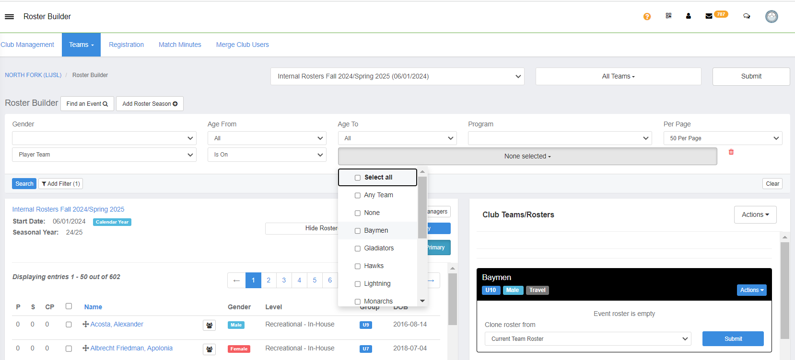
STEP 6: Sort by PLAYER TEAM

Slide 27
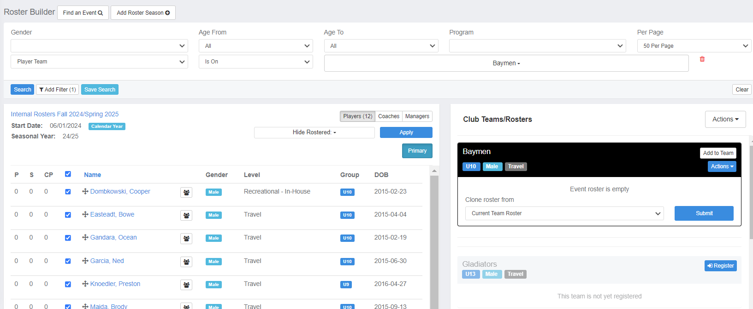
STEP 7: Select Players & Add to Team

Slide 28
REGISTRARS
JUNE 1, 2026
Begin Enrolling Teams
into
LIJSL/ENYYSA 2026-2027
Travel OFFICIAL ROSTERS &
Cards

Slide 29
Fall 2026
Guide to Register TEAMS
Into
LIJSL/ENYYSA 2026-2027
Travel Official Rosters & Cards

Slide 30

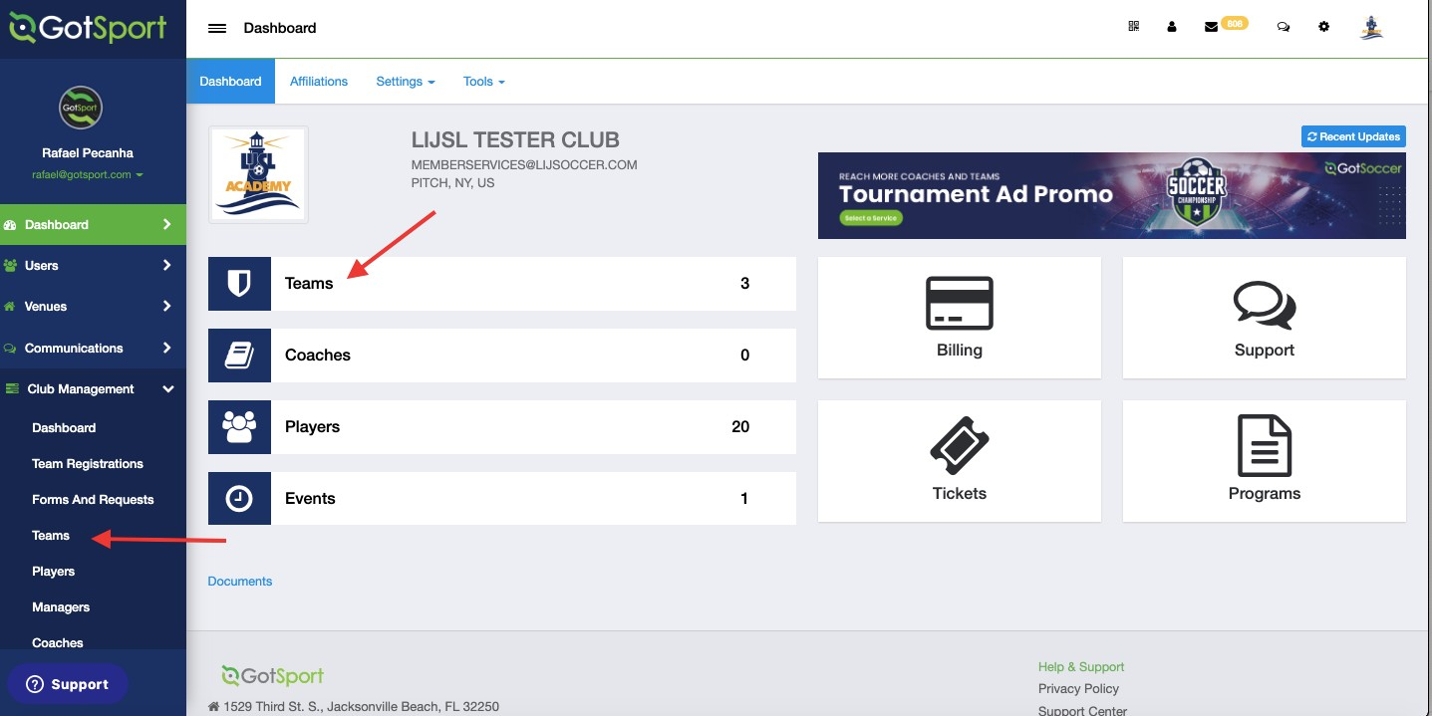
www.gotsport.com
TASK 1
Go to Teams List
Step 1: From your Dashboard, either select the Teams tab or click the Club Management module on the left-hand side and select Teams

Slide 31
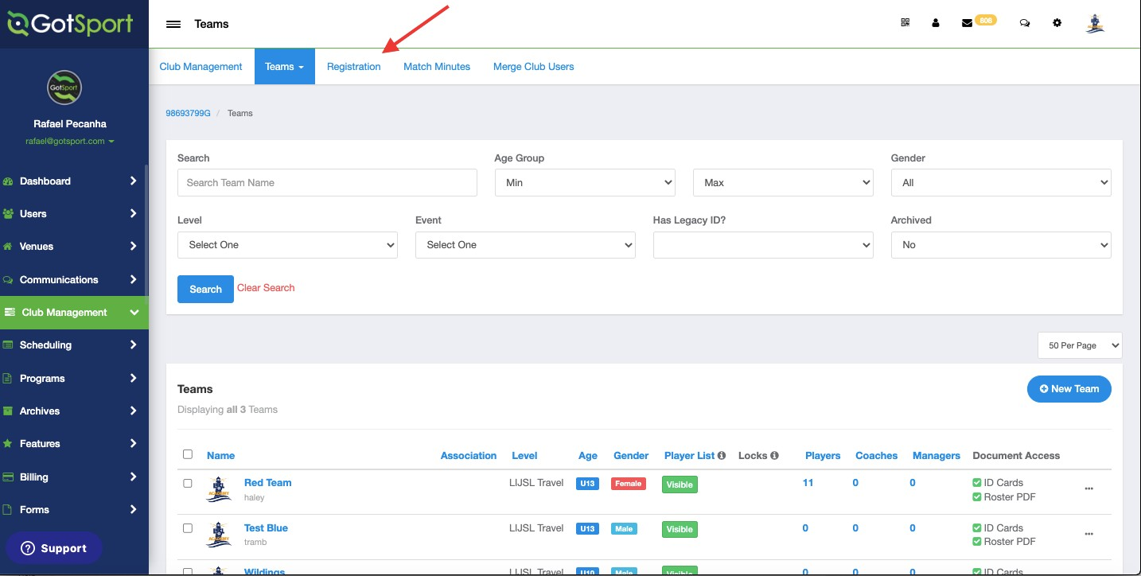
www.gotsport.com
TASK 2
Click Registration Tab
Step 1: Once On the Teams Page, Click Registration Tab to scroll Down and Find The Official Event for LIJSL

Slide 32
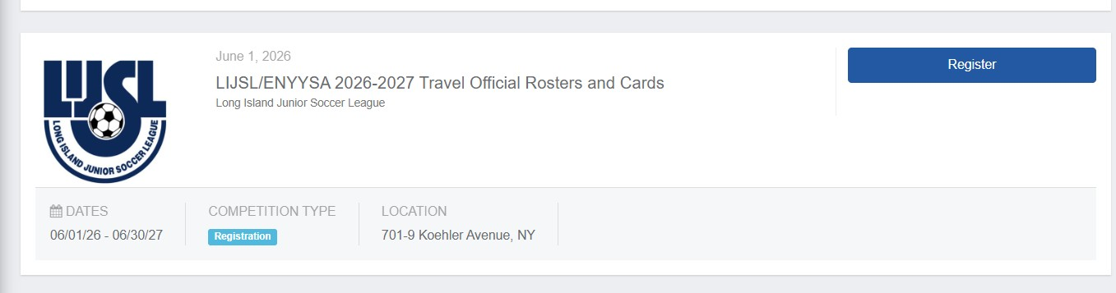
Locate the ENYYSA/LIJSL 2026/2027 official rosters & cards event
TASK 3

Slide 33
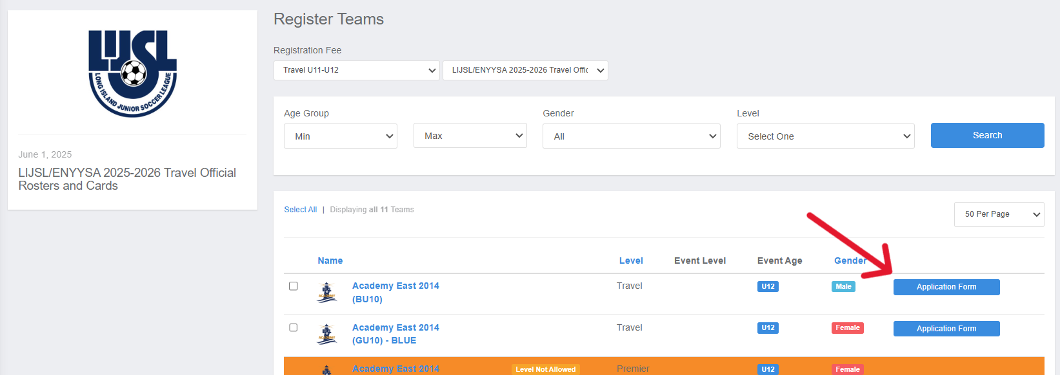
TASK 4
Register for the roster and player cards event
Step 1: Click The Register Button From the Previous Image. Then Click Application Form. You Need To Register One Team At A Time then return to this screen and register the next team.

Slide 34
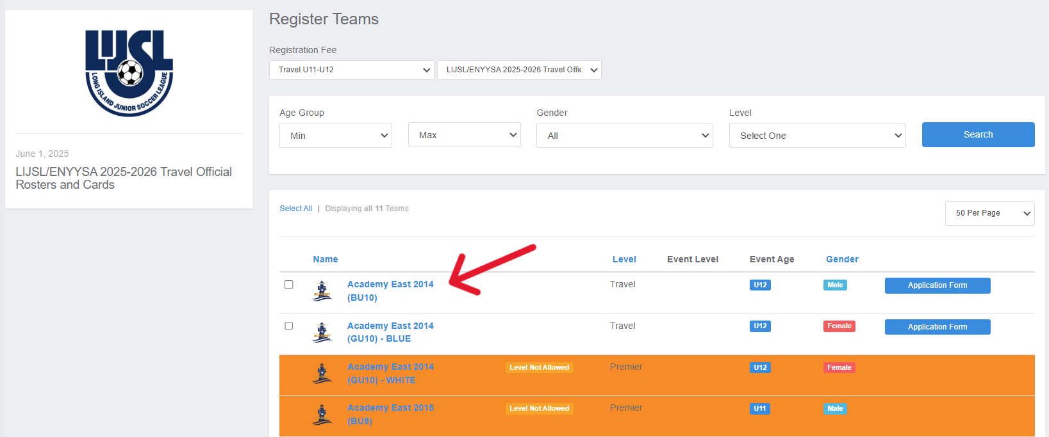
In Case You See A Message Stating That The Level Is Not Allowed, You Can Click On The Team Name and Change it Before Clicking Save At The Bottom.

Slide 35
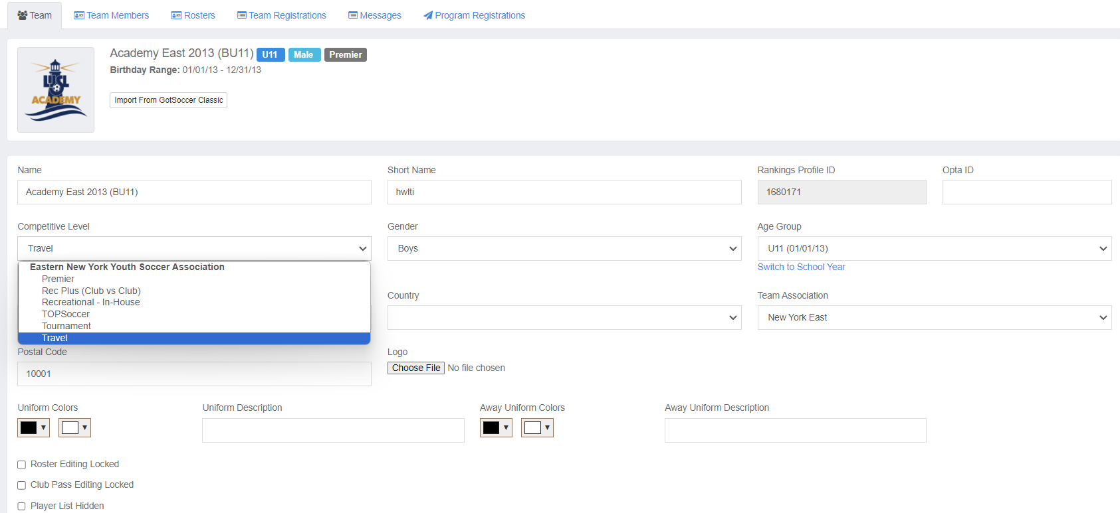
Click “Competitive Level” And Make Sure Travel is Selected.

Slide 36
REGISTRARS DIGITAL PACKET
What to bring to appointment.
FALL 2026 Fees
Registration Appointment Dates
FALL Calendar
Referee Fees
Player Age Groups
2026 U9-U19 Field Chart
U9-U10 Build-Out Line
Sunrise Sunset
Add/Delete Form
Game/Time Change Request Form
Alignment Sample Form
All forms and tutorials will be available on LIJSL Website
www.lijsoccer.com > resources > forms
**NEW** LIJSL Intramural Registration Process Tutorial**

Slide 37
WHAT YOU NEED TO BRING TO YOUR
FALL 2026 REGISTRATION APPOINTMENT
TEAM NAME/NUMBER FORM - MUST BE FILLED OUT.
GAME CHANGE REQUEST FORMS (If Needed) - For LIJSL FALL Season the Game Change request forms must be filled out with supporting documentation and signed by Registrar.
Club Payment - Check- Credit Card – ACH. Must be paid at Registration.
Club Personnel Form.
All Forms Must Be Correctly Filled Out, Signed and Legible

Slide 38
Travel Team Fee - $395
Fall Late Season – Registration – September 14-18, 2026
REMINDER TO REGISTER ALL INTRAMURAL & TOPS SOCCER PLAYERS
ROSTER MAX –
U9 – U10 # 14
U11–U12 # 18
U13-U19 # 22

Slide 39

Games Chair
Tim Stalker
LIJSLGAMES@GMAIL.COM

Slide 40
ALIGNMENTS
Tools have been added in the registration process to help with the aligning of teams.
The Games committee would like to ask that you use these tools to the fullest ability. These fields are essential for your team to be placed properly. Every season at least 50% of the comments are blank or have comments like "Lost Players“. Everyone loses players, or "move down 1 division", when that team had a successful season.
Many times, very little is written on the initial registration information and then Games will get a very long explanation during the ACRF process. The issue is at this point teams have received notification of their alignments, and it is very difficult to move teams at that time.
Games Committee have 4 days to align 1300 teams with 10 volunteers. Please assist them by putting as much information as possible in the initial registration file.
If there are any major changes to a team from the time of registration to the time of alignments, please send me an email letting me know the updated information, so we have it for the alignment.

Slide 41
HAVE A GREAT FALL SEASON
#BuildingCharacterThroughSoccer

