Slide 1
WELCOME
SPRING 2024 REGISTRARS MEETING

Slide 2
PRESENTER
Sonia Kelly
LIJSL
Operations Manager
&
LEAGUE REGISTRAR

Slide 3
WHAT YOU NEED TO BRING TO YOUR
SPRING 2024 REGISTRATION APPOINTMENT
TEAM NAME/NUMBER FORM - MUST BE FILLED OUT.
GAME CHANGE REQUEST FORMS (If Needed) - For LIJSL Spring Season the Game Change request forms must be filled out with supporting documentation and signed by Registrar.
Club Payment - Check- Credit Card - ACH Must be paid at Registration.
All Forms Must Be Correctly Filled Out, Signed and Legible

Slide 4
REGISTRARS
Begin Enrolling Teams into the
“Spring 2024 LIJSL League”
on
December 1, 2023

Slide 5
Spring 2024
Guide to Register RETURNING
Teams That Did Play Fall 2023

Slide 6
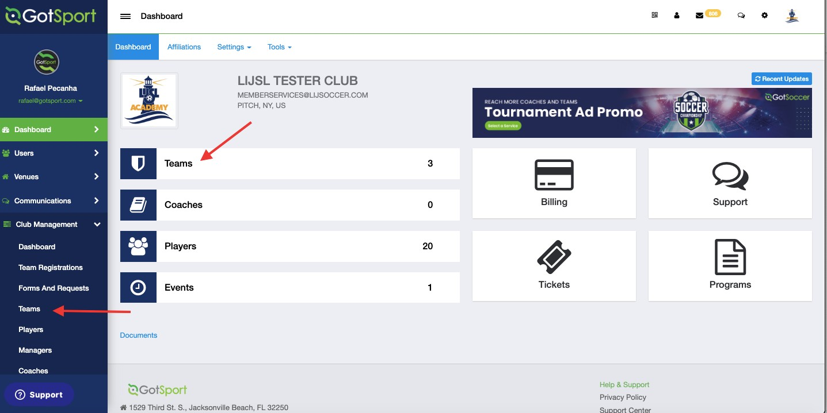
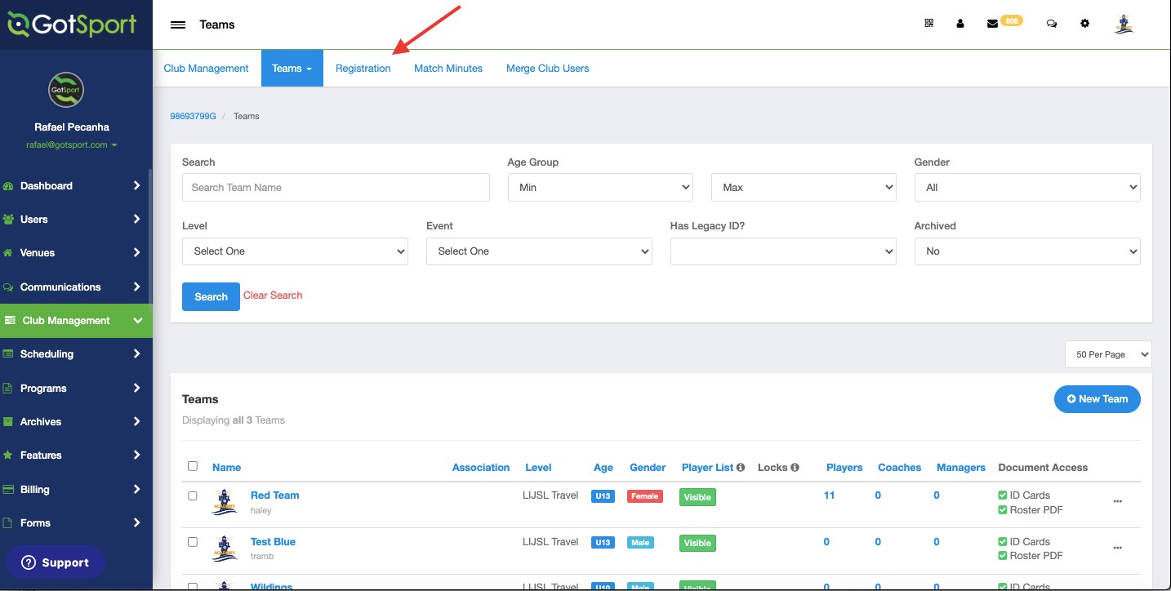
RETURNING TEAMS 2023
www.gotsport.com
TASK 1
Login and go to your teams list
Step 1: From your Dashboard, either select the Teams tab or click the Club Management module on the left-hand side and select Teams
TASK 2
Register Your Teams To The Spring Event
Step 1: Click The Registration Tab and Scroll Down to find the LIJSL Spring Event and Click Register
3

Slide 7
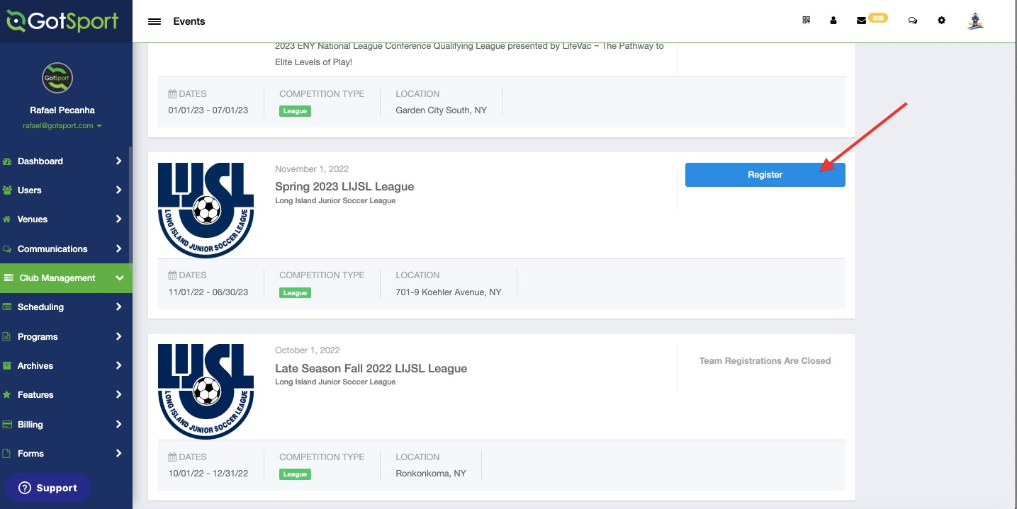
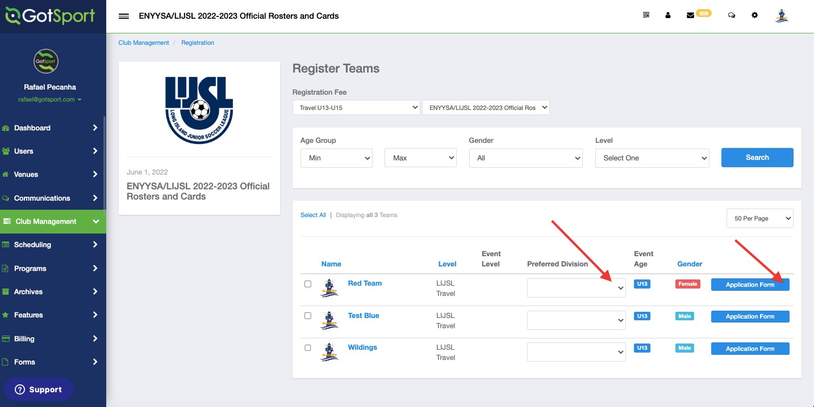
TASK 3
Locate the Spring 2023 League and hit "Register"
www.gotsport.com
Task 4
Register your teams with LIJSL Spring
Step 1: Make sure level and age group are selected. The preferred division also needs to be selected. You need to register one team at a time. Once you click the "Appliction Form" button complete the reamining registration questions then come back and do it for the next team.
*FAQ – If you see a yellow warning that says "LEVEL NOT ALLOWED" see the last page of this document for help.
4

Slide 8
Spring 2024
Guide to Register NEW TEAMS
That Did Not Play Fall 2023

Slide 9
NEW TEAMS THAT DID NOT PLAY FALL 2023
www.gotsport.com
TASK 1
Go to Teams List
Step 1: From your Dashboard, either select the Teams tab or click the Club Management module on the left-hand side and select Teams
TASK 2
Click Registration Tab
Step 1: Once On the Teams Page, Click Registration Tab to scroll Down and Find The Official Event for LIJSL

Slide 10
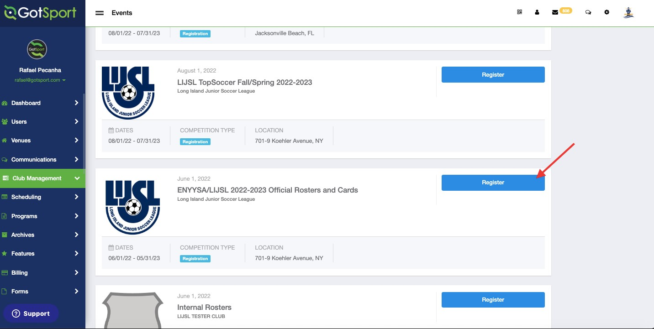
TASK 3
Locate the ENYYSA/LIJSL 22/23 official rosters & cards event
TASK 4
Register for the roster and player cards event
Step 1: Click The Register Button From the Previous Image and Make Sure You Are Selecting the Preferred Division. You Need To Register One Team At A Time then return to this screen and register the next team.

Slide 11
TASK 5
Register For The Spring Event
Step 1: After Registering For The Roster and Player Cards Event, You Would Need to Register For The Spring Event. By Following The Same Steps To Make It To The Teams Page And Click The Registration Tab.
TASK 6

Slide 12
www.gotsport.com
TASK 7
Scroll Down To Find The Spring Event
After Finding The Spring Event, You Need To Click Register. From There, Select The Team, the Preferred Division And The Correct Team Level. You Need To Register One Team At A Time.
*Please, next page in case you see the yellow message "Level not allowed."

Slide 13
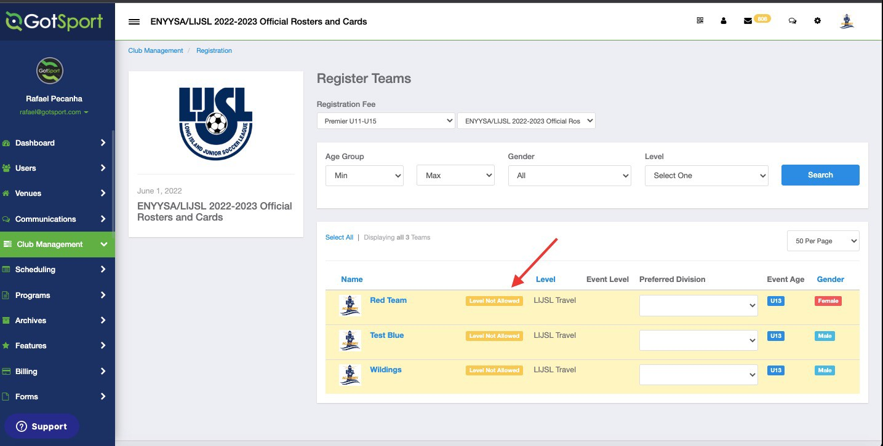
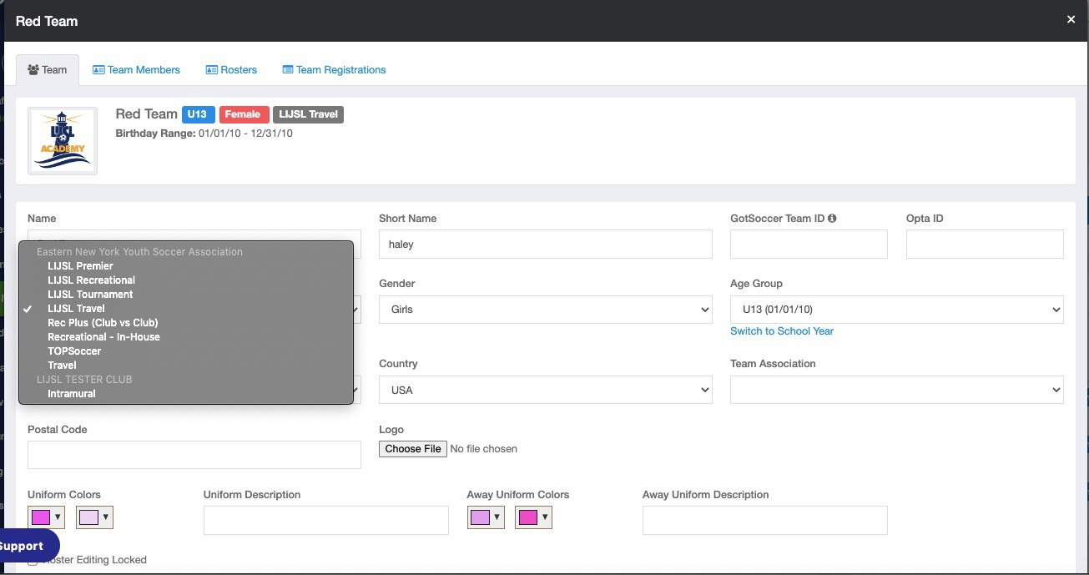
FAQ*
In Case You See A Message Stating That The Level Is Not Allowed, You Can Click On The Team Name and Change it Before Clicking Save At The Bottom.

Slide 14
REGISTRTION APPOINTMENT DATES
January 4, 2024 - January 24, 2024
8:30 AM - 7:00 PM
Saturday January 20th (If Needed)
8:00 AM - 12:00 PM
Martin Luther King Day
January 15th, 2024 - Office CLOSED
CONTACT
LIJSL OFFICE - 1.631.648.9020
CORA FITZGERALD – memberservices@lijsoccer.com
Or
HALEY KOZIK – adminservices@lijsoccer.com
** YOU CANNOT CHANGE THE DATE Once An Appointment Is Made**

Slide 15
REGISTRARS PACKET
What to bring to appointment.
Spring 2024 Fees
Registration Appointment Dates
Spring 2024 Calendar
Referee Fees
Field Chart
Sunrise Sunset
Add/Delete Form
Player Drop Form
Game/Time Change Request Form
All forms and tutorials will be available on LIJSL Website
www.lijsoccer.com > resources > forms
**NEW** LIJSL Intramural Registration Process Tutorial**

Slide 16
LI CUP 2024
STEPHANIE HERNANDEZ
PROGRAMS & EVENTS

Slide 17
LI CUP Rosters will freeze 10 days prior to Round 1 March 13th, 2024.
LI Cup Weekend: First Round will be March 23rd & 24th
ALL TEAMS:
Are automatically entered into the LI CUP.
If your team is opting out, you no longer need to fill out the LI CUP Withdrawal form.
YOU MUST CLICK AT REGISTRATION THE OPTING OUT BUTTON, “MY TEAM IS NOT PARTICIPATING IN THE SPRING 2024 LI CUP”.
LI Cup Finals Weekend:
June 8th & 9th @ HBC Soccer Complex.
No special requests will be accepted for the LI CUP Finals.
All final games will get scheduled for that weekend. Our goal is to have ALL teams participate in the Cup. PLEASE check with your teams if they are available to play that weekend if they advance to the finals. We had multiple teams not able to play on “FINALS” weekend due to other sports thinking they would not have advanced

Slide 18
Games Chair
Tim Stalker

Slide 19
ALIGNMENTS
Tools have been added in the registration process to help with the aligning teams.
The Games committee would like to ask that you use these tools to the fullest ability. These fields are essential for your team to be placed properly. Every season at least 50% of the comments are blank or have comments like "Lost Players“. Everyone loses players, or "move down 1 division", when that team had a successful season.
Many times, very little is written on the initial registration information and then Games will get a very long explanation during the ACRF process. The issue is at this point teams have received notification of their alignments, and it is very difficult to move teams at that time.
Games Committee have 4 days to align 1300 teams with 10 volunteers. Please assist them by putting as much information as possible in the initial registration file.

Slide 20
HAVE A GREAT SPRING SEASON
#BuildingCharacterThroughSoccer

